Slide 1
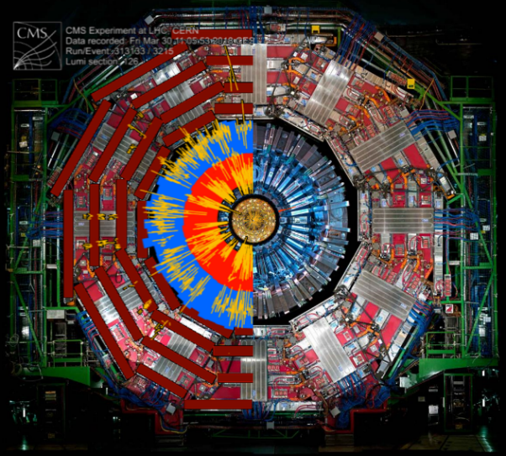

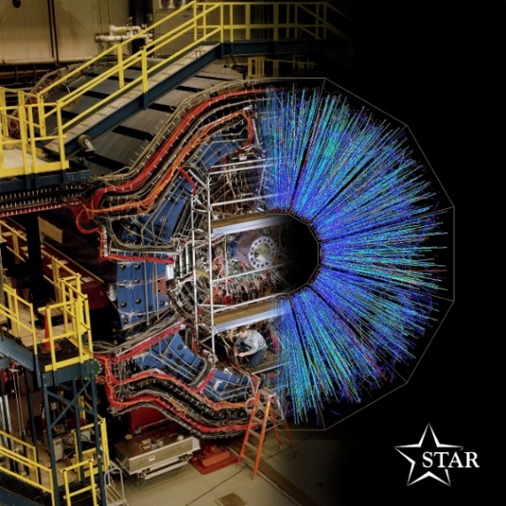
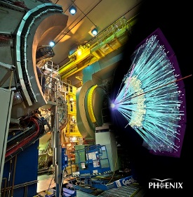




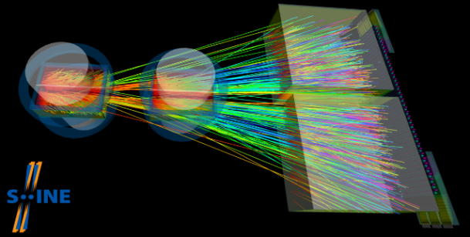
Exploring the Big Bang in the Lab with Femtoscopy and Lévy-stable distributions
máté Csanád (Eötvös University)
Building Bridges 2023: 34th Annual conference of Academia Europaea

Slide 2
Contents of this talk
Introduction to particle physics and the strong interaction
Big bang in the lab: basics of high-energy physics
Quantum-statistics and the HBT effect
Exploring femtometer geometry with femtoscopy
Summary
INTRODUCTION HIGH-ENERGY PHYSICS QUANTUM STATISTICS FEMTOSCOPY

Slide 3
Contents of this talk
Introduction to particle physics and the strong interaction
Big bang in the lab: basics of high-energy physics
Quantum-statistics and the HBT effect
Exploring femtometer geometry with femtoscopy
Summary
INTRODUCTION HIGH-ENERGY PHYSICS QUANTUM STATISTICS FEMTOSCOPY

Slide 4
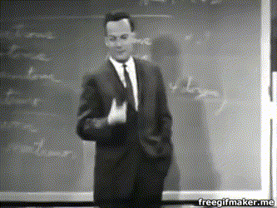
Finding new laws of nature (R. P. Feynman)
First, we guess it [a new law of nature]. Then we compute the consequences of the guess … and then we compare those to nature, to experiment or experience, directly with observation to see if it works.
If it disagrees with experiment, it’s wrong.
In that simple statement, is the key to science:
it doesn’t make any difference how beautiful your guess is; it doesn’t make any difference how smart you are, who made the guess, or what his name is — if it disagrees with experiment, it’s wrong; that’s all there is to it.
R. P. Feynman, 1964
INTRODUCTION HIGH-ENERGY PHYSICS QUANTUM STATISTICS FEMTOSCOPY

Slide 5
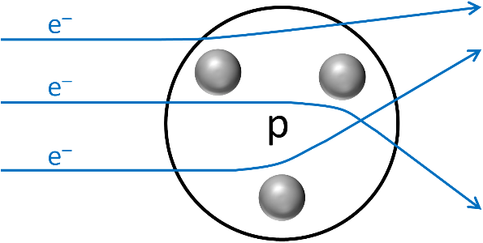
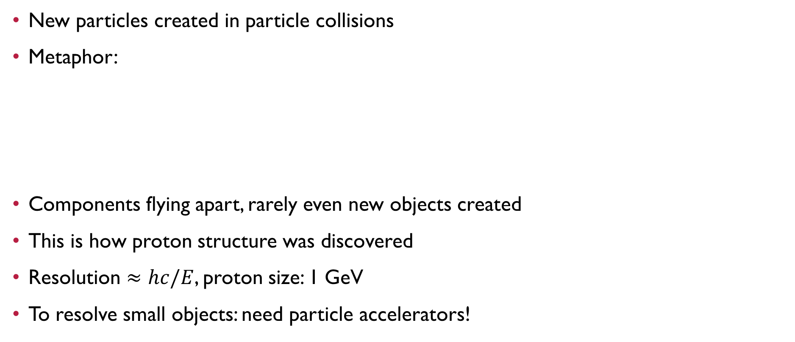
Method of Particle physics
New particles created in particle collisions
Metaphor:
Components flying apart, rarely even new objects created
This is how proton structure was discovered
Resolution $≈hc/E$, proton size: 1 GeV
To resolve small objects: need particle accelerators!
INTRODUCTION HIGH-ENERGY PHYSICS QUANTUM STATISTICS FEMTOSCOPY

Slide 6



Standard model of particle physics
Interactions: weak (radioactive decays), electromagnetic, strong (nuclear physics)
Interactions mediated by exchange (gauge) bosons
Constituents of ordinary matter: up and down quarks, electrons
First microseconds after the Big Bang: strong interaction important
fermions
interactions
bosons
u
up
c
charm
t
top
g
gluon
H
Higgs boson
quarks
strong
d
down
s
strange
b
bottom
γ
foton
electromagnetic
weak
e
electron
μ
muon
τ
tau
Z
Z boson
leptons
ν_{e}
electron neutrino
ν_{μ}
muon neutrino
ν_{τ}
tau neutrino
W
W boson
INTRODUCTION HIGH-ENERGY PHYSICS QUANTUM STATISTICS FEMTOSCOPY

Slide 7
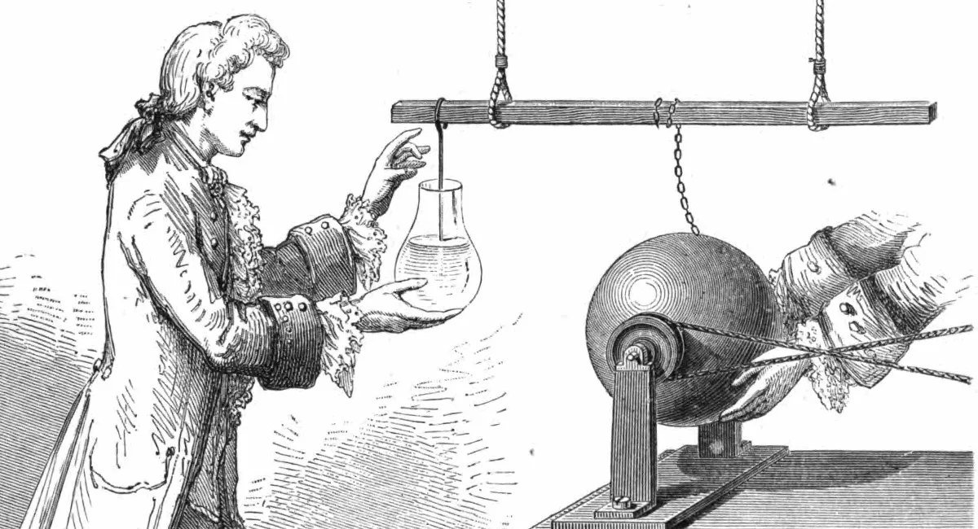

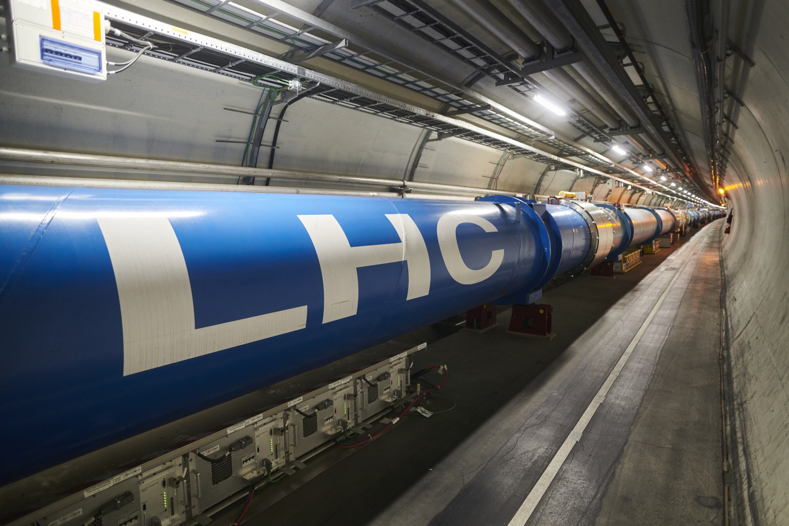
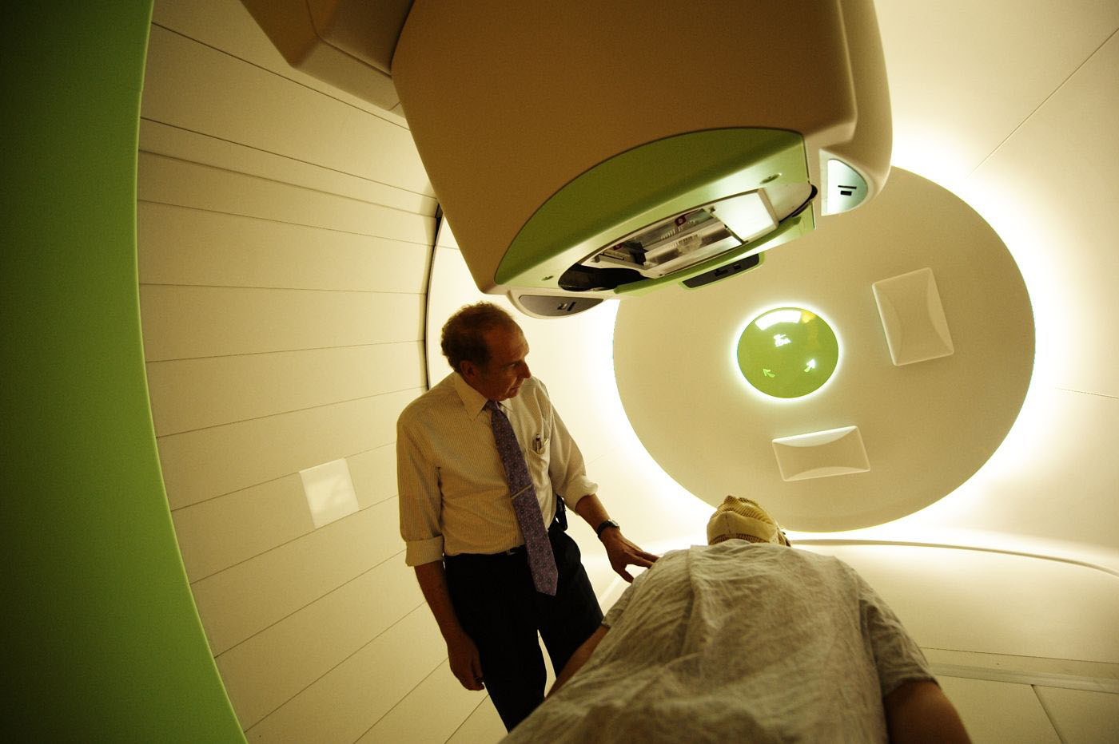
Why Study the strong interaction?
Electromagnetism: discovery to applications
  1750-90: discovery
  1830-70: explanation
  1876: telephone
  Early 20th century: TV, computers
  Late 20th century: Internet, touchscreen
Understanding the strong interaction
  ~1930: discovery
  ~1970: explanation
  ~2000: huge particle accelerators
  ~21st century: first applications
Strong interaction technology? Proton and ion therapy!
INTRODUCTION HIGH-ENERGY PHYSICS QUANTUM STATISTICS FEMTOSCOPY

Slide 8
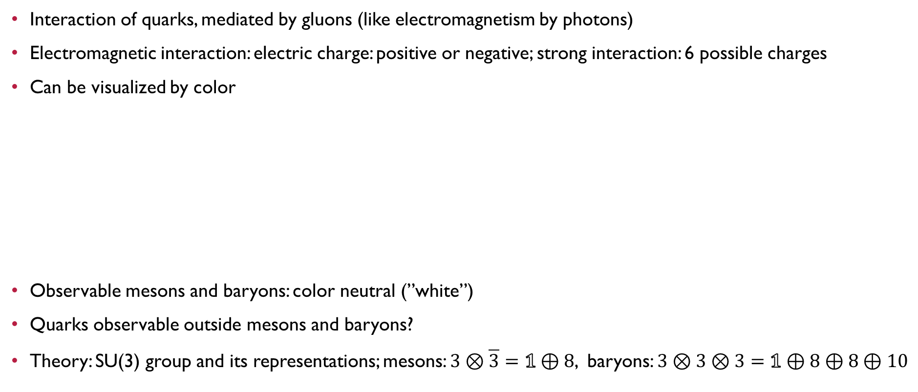
Quarks, gluons and ”color”: strong interaction
Interaction of quarks, mediated by gluons (like electromagnetism by photons)
Electromagnetic interaction: electric charge: positive or negative; strong interaction: 6 possible charges
Can be visualized by color
Observable mesons and baryons: color neutral (”white”)
Quarks observable outside mesons and baryons?
Theory: SU(3) group and its representations; mesons: $3⊗\overline{3}=1⊕8$, baryons: $3⊗3⊗3=1⊕8⊕8⊕10$
HADRONS
QUARKS
green, red & blue
ANTIQUARKS
magenta, cyan & yellow
mesons
baryons
antibaryons
INTRODUCTION HIGH-ENERGY PHYSICS QUANTUM STATISTICS FEMTOSCOPY

Slide 9
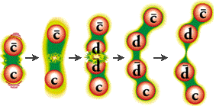
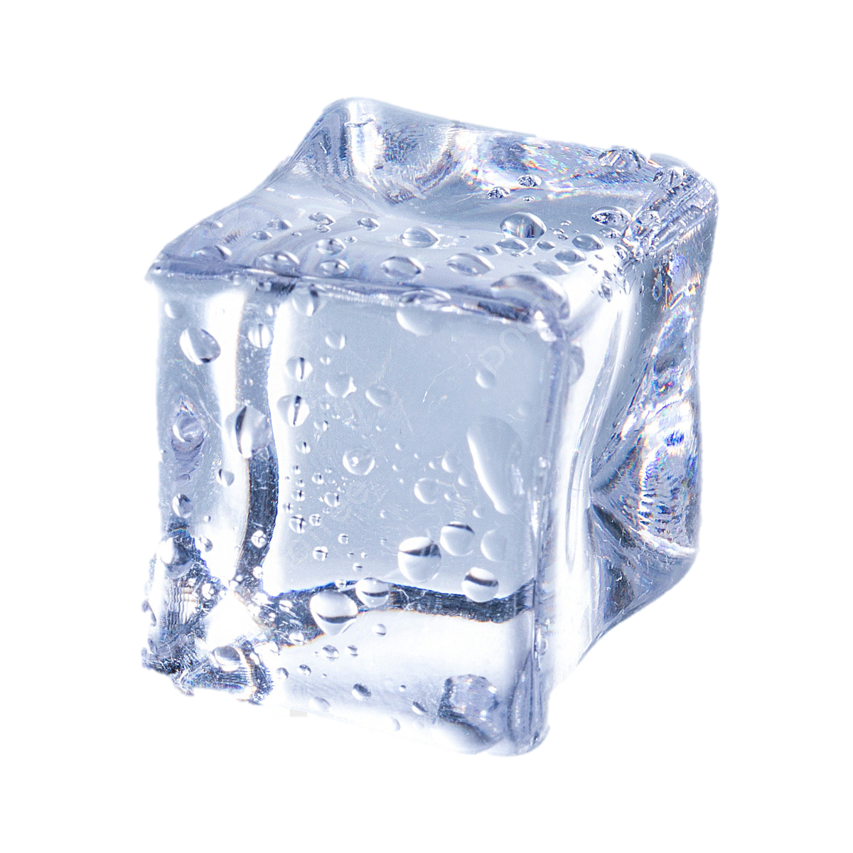
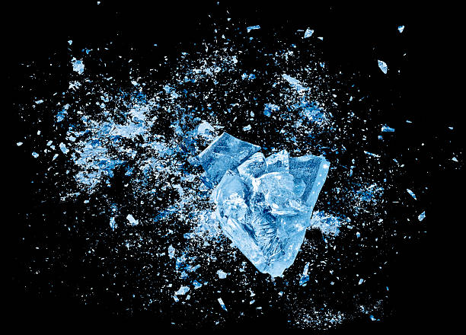

Quark Confinement
Free quarks not observable, only in hadrons
Increased distance: huge energy (potential)
  Additional quarks created
  Again confined
”Opposite”: asymptotic freedom at extreme temperatures
Extreme temperatures: quark-gluon plasma
  Last present in the first μs after Big Bang
  How to melt nuclei here on Earth?
  Analogy: frozen world, melting ice via collisions
u
c
d
u
c
INTRODUCTION HIGH-ENERGY PHYSICS QUANTUM STATISTICS FEMTOSCOPY

Slide 10
Contents of this talk
Introduction to particle physics and the strong interaction
Big bang in the lab: basics of high-energy physics
Quantum-statistics and the HBT effect
Exploring femtometer geometry with femtoscopy
Summary
INTRODUCTION HIGH-ENERGY PHYSICS QUANTUM STATISTICS FEMTOSCOPY

Slide 11
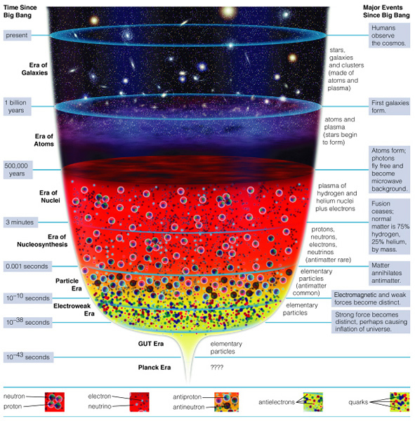
Big Bang in the lab
Ages of the Universe:
  Stars & Galaxies (after few 100M years)
  Atoms (after ~400k years)
  Nuclei (after ~3 minutes)
  Nucleosynthesis (first 3 minutes)
  Strong interaction era (first microsecond)
  … ?
How to investigate?
  Create little bangs
  Collisions of heavy ions
  Record outcoming particles
  Find clever observables from data
INTRODUCTION HIGH-ENERGY PHYSICS QUANTUM STATISTICS FEMTOSCOPY

Slide 12
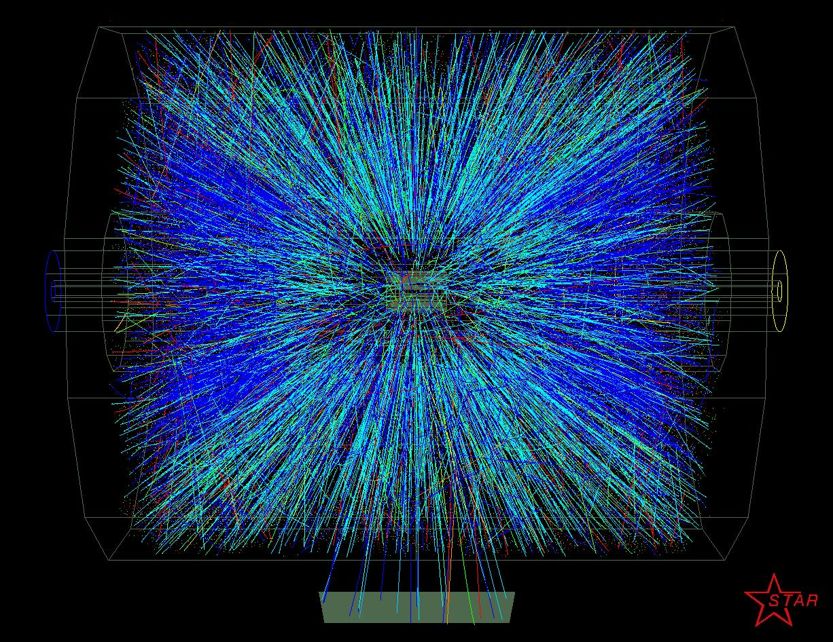
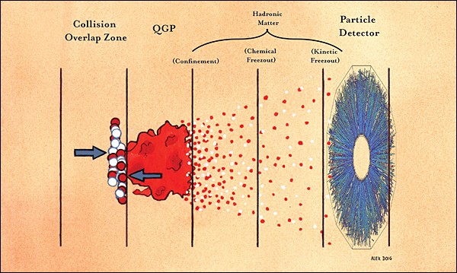
Timeline of little bangs in particle accelerators
Pre-thermalization stage:
most energetic interactions
duration: ~1 fm/c
Hydrodynamic explosion,
duration: ~10 fm/c
Quark-hadron transition, free streaming → detectors
INTRODUCTION HIGH-ENERGY PHYSICS QUANTUM STATISTICS FEMTOSCOPY

Slide 13
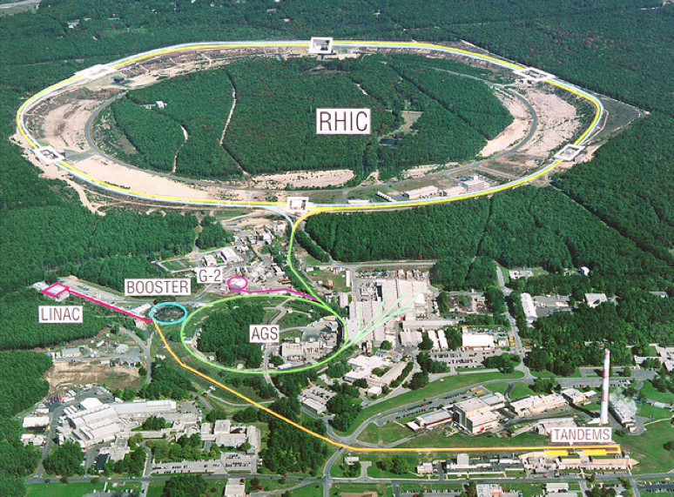
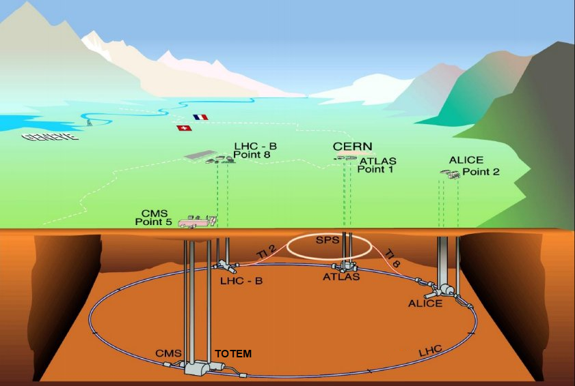
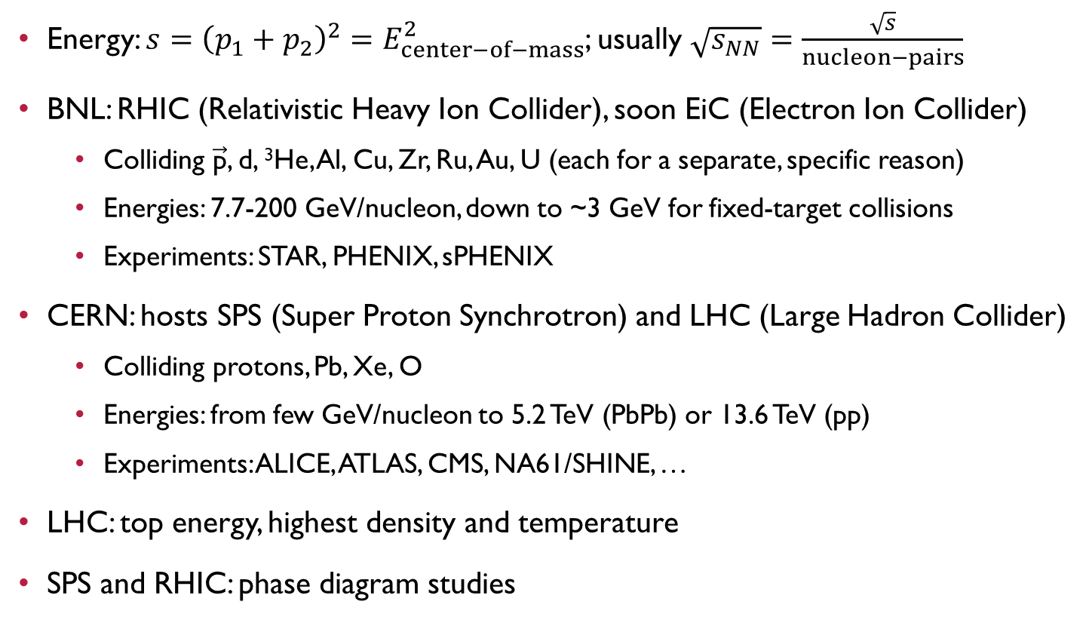
Facilities: SPS, RHIC, LHC
Energy: $s={\left(p_{1}+p_{2}\right)}^{2}=E_{center−of−mass}^{2}$; usually $\sqrt{s_{NN}}=\frac{\sqrt{s}}{nucleon−pairs}$
BNL: RHIC (Relativistic Heavy Ion Collider), soon EiC (Electron Ion Collider)
  Colliding $\vec{\text{p}}$, d, ³He, Al, Cu, Zr, Ru, Au, U (each for a separate, specific reason)
  Energies: 7.7-200 GeV/nucleon, down to ~3 GeV for fixed-target collisions
  Experiments: STAR, PHENIX, sPHENIX
CERN: hosts SPS (Super Proton Synchrotron) and LHC (Large Hadron Collider)
  Colliding protons, Pb, Xe, O
  Energies: from few GeV/nucleon to 5.2 TeV (PbPb) or 13.6 TeV (pp)
  Experiments: ALICE, ATLAS, CMS, NA61/SHINE, …
LHC: top energy, highest density and temperature
SPS and RHIC: phase diagram studies
INTRODUCTION HIGH-ENERGY PHYSICS QUANTUM STATISTICS FEMTOSCOPY

Slide 14
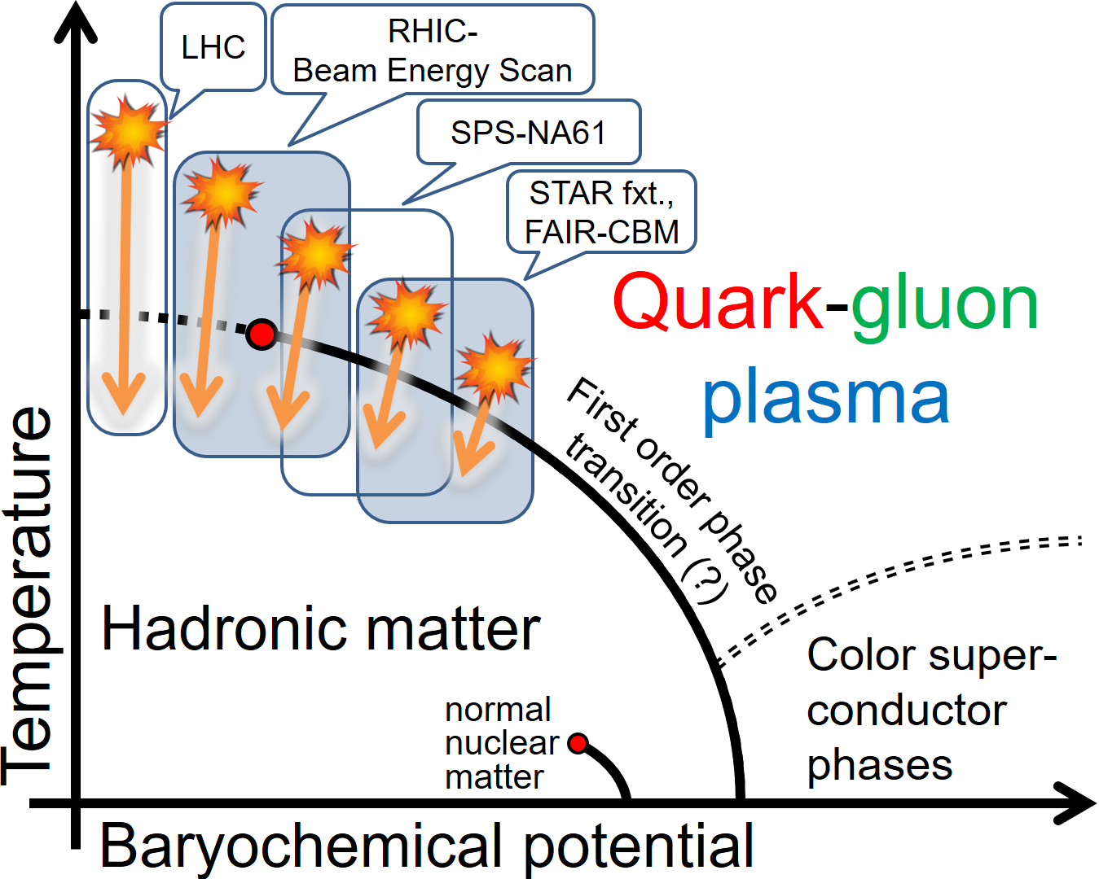

Exploring the Phase map of QCD
Why so many facilities? Explore phase map!
Control parameters:
  Collision energy, system, geometry
  Affecting temperature and density
Phase map: temperature versus matter excess
(baryochemical potential μ_{B})
  Crossover at low μ_{B} and T$≅$160 MeV
  Probably 1st order quark-hadron phase transition
  at high μ_{B} (NJL, bag model, etc)
  Critical End Point (CEP) in between, at some μ_{B} and T_{c}?
  High μ_{B}: nuclear matter, neutron stars, color superconductors…
Phase transition importance: even in core-collapse supernovae!
+J-PARC HI
+NICA
INTRODUCTION HIGH-ENERGY PHYSICS QUANTUM STATISTICS FEMTOSCOPY

Slide 15
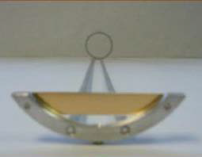

Extending the reach: fixed target collisions
Collider: $\sqrt{s_{NN}}=E_{beam}+E_{beam}$ Fixed target: $\sqrt{s_{NN}}=\sqrt{2⋅M_{p}⋅E_{beam}}$
Energies unreachable in collider mode
Chemical potentials reachable by RHIC in collider mode: 20-420 MeV
Chemical potentials in fixed target mode: 420-721 MeV
LHC: ~0.5-1 MeV
Collider Energy [GeV] | Single beam energy [GeV] | Fixed target c.m. energy[GeV] | Beam rapidity | μ_{B} [MeV]
200.0 | 100.00 | 13.71 | 2.10 | 260
62.4 | 31.20 | 7.74 | 2.10 | 420
39.0 | 19.50 | 6.17 | 1.87 | 487
27.0 | 13.50 | 5.19 | 1.68 | 541
19.6 | 9.80 | 4.47 | 1.52 | 589
11.5 | 5.75 | 3.53 | 1.25 | 666
9.1 | 4.59 | 3.20 | 1.13 | 699
7.7 | 3.85 | 2.98 | 1.05 | 721
gold target foil
a fixed target event
INTRODUCTION HIGH-ENERGY PHYSICS QUANTUM STATISTICS FEMTOSCOPY

Slide 16

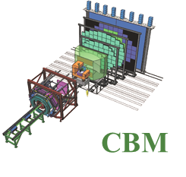
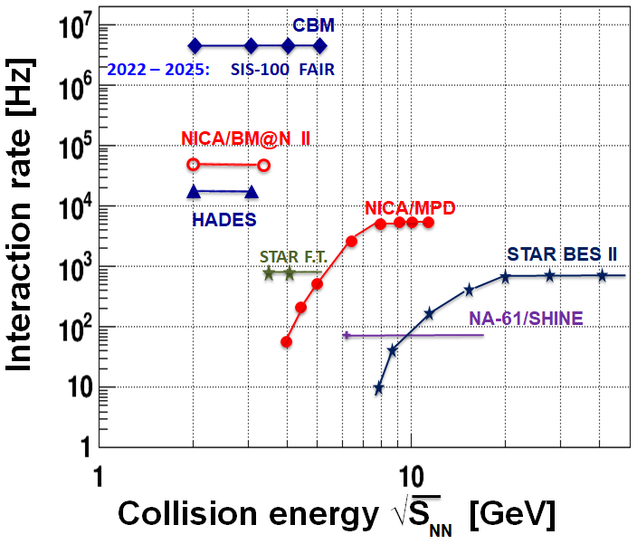

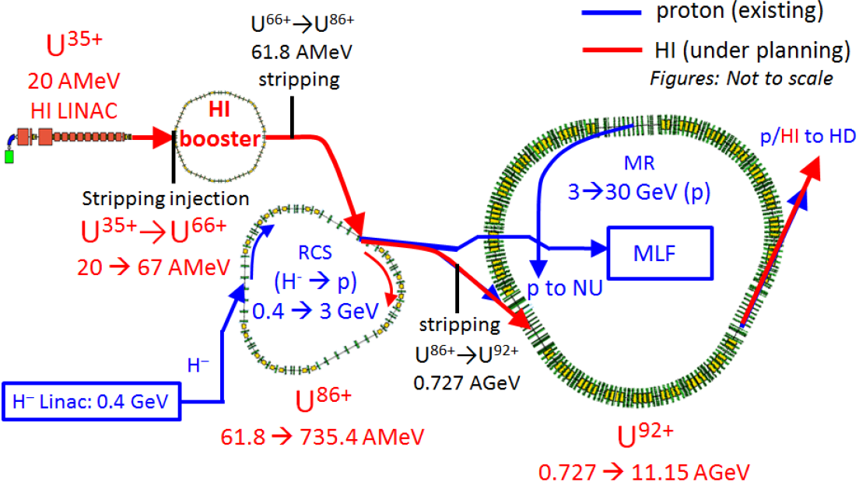
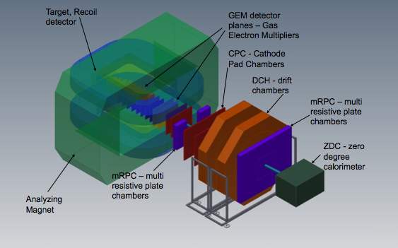

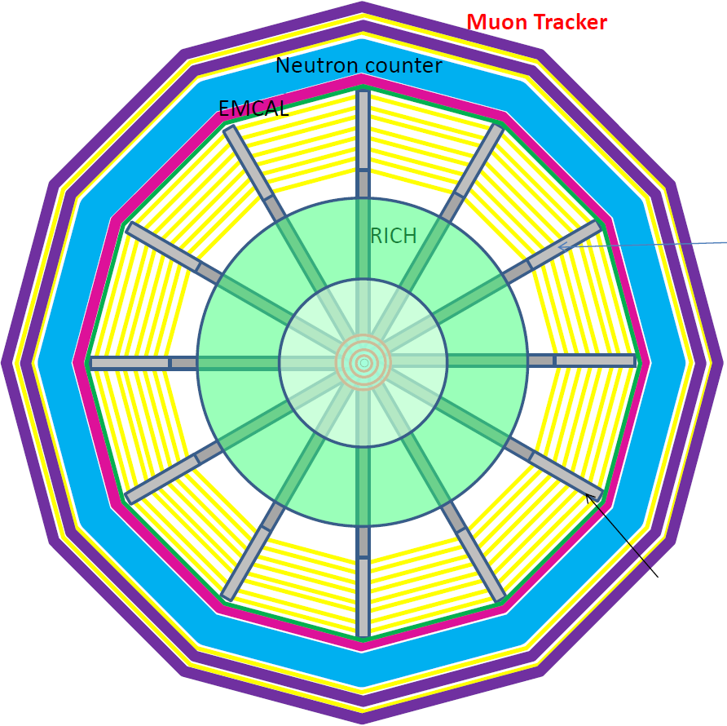
Future facilities: NICA, FAIR, J-PARC HI
New facilities planned/built
NICA: 2020, experiments: MPD & BM@N ?
FAIR: 2025, experiment: CBM
J-PARC HI: 2027, experiment: JHITS
SIS100/300
FAIR phase 1
FAIR phase 2
J-PARC HI
NICA
INTRODUCTION HIGH-ENERGY PHYSICS QUANTUM STATISTICS FEMTOSCOPY

Slide 17
Contents of this talk
Introduction to particle physics and the strong interaction
Big bang in the lab: basics of high-energy physics
Quantum-statistics and the HBT effect
Exploring femtometer geometry with femtoscopy
Summary
INTRODUCTION HIGH-ENERGY PHYSICS QUANTUM STATISTICS FEMTOSCOPY

Slide 18
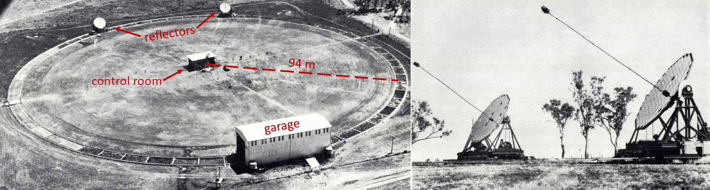
A surprising discovery: HBT correlations
Radio astronomy: Jansky, 1933, weird 24h oscillation; stars also emit EM radiation in the radio domain!
R. H. Brown: investigated radio waves from stars
  Jordell Bank (optical and radio telescopes), tabletop experiment (optics), Narrabri (stellar interferometer)
R. Q. Twiss helped to understand results mathematically
Weird correlation in all experiments
INTRODUCTION HIGH-ENERGY PHYSICS QUANTUM STATISTICS FEMTOSCOPY

Slide 19
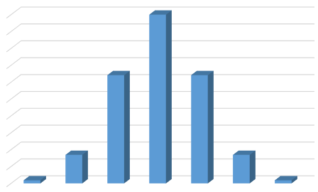
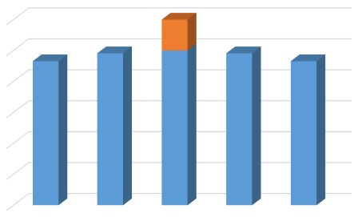
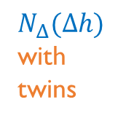



Why are correlations useful?
Frequency of a given height in a population/sample: $N(h)$
Height densities: $N_{Δ}\left(Δh\right)=\left\langle N\left(h\right)N\left(h+Δh\right)\right\rangle$, averaging on $h$
Simplest case:
both $N(h)$ and $N_{Δ}\left(Δh\right)$
Gaussian
Except if lot of identical twins:
unexpected number of same height pairs –
increase at zero!
Then $N_{Δ}\left(0\right)>\left\langle N\left(h\right)N\left(h\right)\right\rangle$
Correlation: tells the number of identical twins!
$$N(h)$$
$$N_{Δ}(Δh)$$
140 150 160 170 180 190 200
-45 -30 -15 0 15 30 45
height [cm]
height difference [cm]
$N_{Δ}(Δh)$ with twins
-4 -2 0 2 4
heigth difference [cm]
INTRODUCTION HIGH-ENERGY PHYSICS QUANTUM STATISTICS FEMTOSCOPY

Slide 20
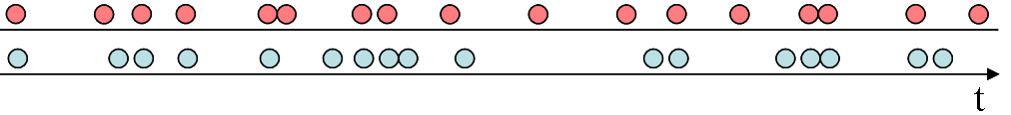
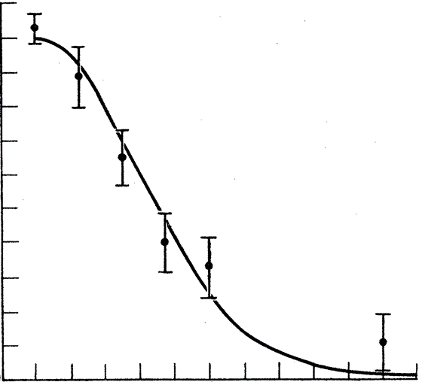
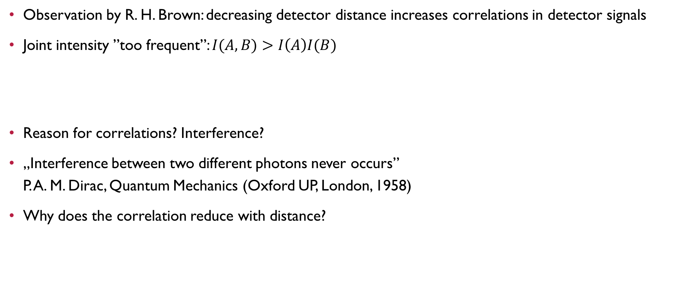
The HBT correlation
Observation by R. H. Brown: decreasing detector distance increases correlations in detector signals
Joint intensity ”too frequent”: $I(A,B)>I\left(A\right)I(B)$
Reason for correlations? Interference?
„Interference between two different photons never occurs”
P. A. M. Dirac, Quantum Mechanics (Oxford UP, London, 1958)
Why does the correlation reduce with distance?
correlation strength
distance
detector distance
INTRODUCTION HIGH-ENERGY PHYSICS QUANTUM STATISTICS FEMTOSCOPY

Slide 21
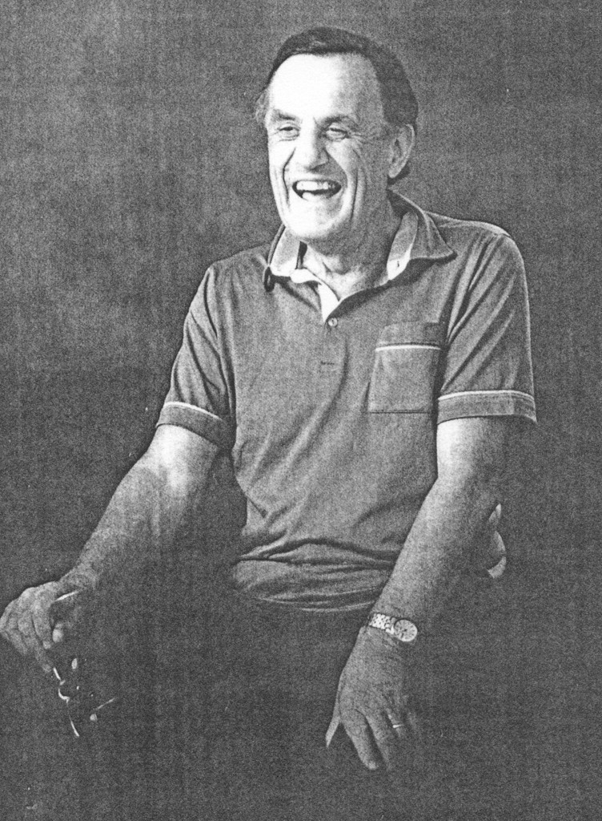
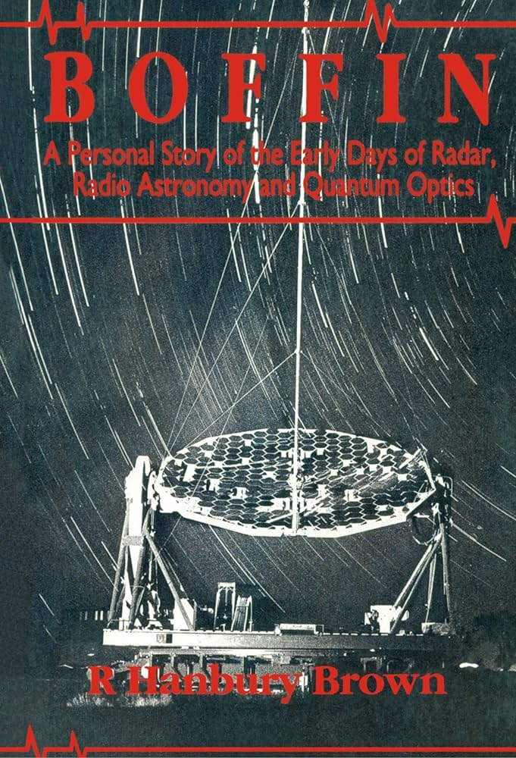
Ignorance is sometimes a bliss in science
„In fact, to a surprising number of people the idea that the arrival of photons at two separated detectors can ever be correlated was not only heretical but patently absurd, and they told us so in no uncertain terms, in person, by letter, in print, and by publishing the results of laboratory experiments, which claimed to show that we were wrong.”
„I was a long way from being able to calculate, whether
it would be sensitive enough to measure a star.
... my education in physics had stopped far short of the
quantum theory. Perhaps just as well, ignorance is
sometimes a bliss in science.”
R. H. Brown, Boffin: a personal story of radar,
radio astronomy and quantum optics
(Taylor & Francis, 1991)
INTRODUCTION HIGH-ENERGY PHYSICS QUANTUM STATISTICS FEMTOSCOPY

Slide 22
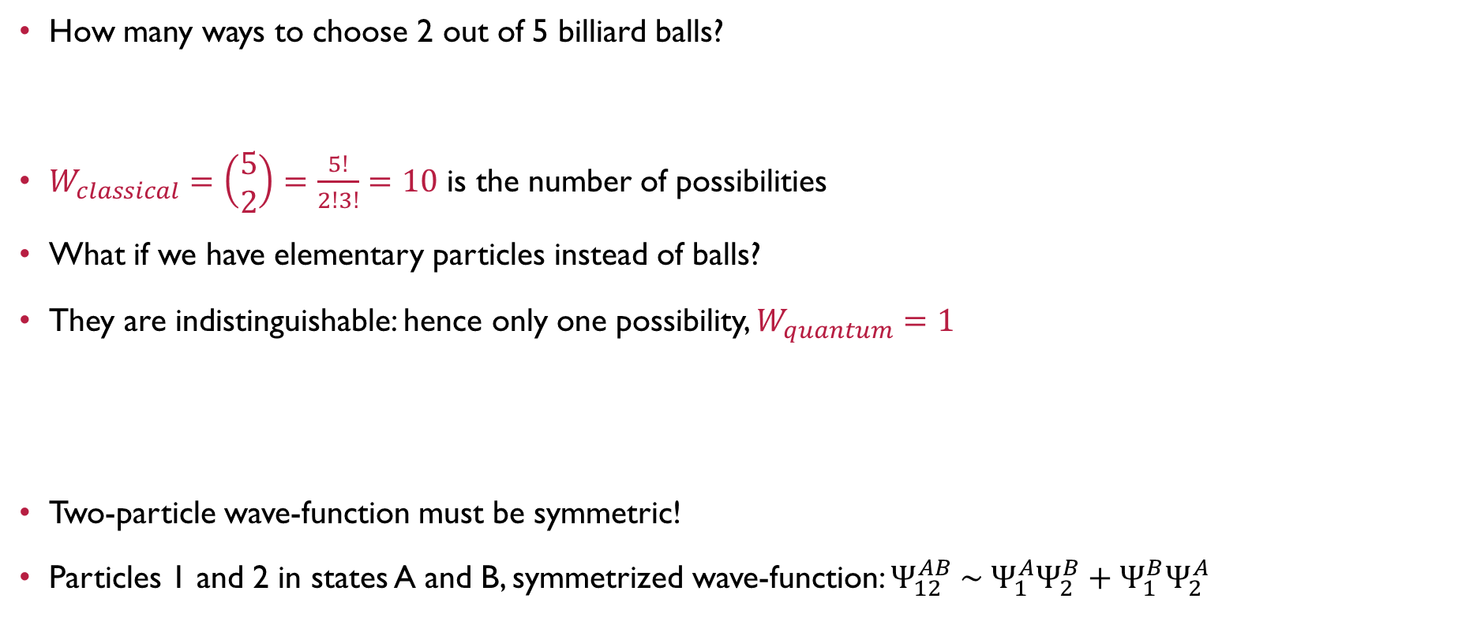
Indistinguishability of elementary particles
How many ways to choose 2 out of 5 billiard balls?
$W_{classical}=\left(\begin{matrix}5 \\ 2\end{matrix}\right)=\frac{5!}{2!3!}=10$ is the number of possibilities
What if we have elementary particles instead of balls?
They are indistinguishable: hence only one possibility, $W_{quantum}=1$
Two-particle wave-function must be symmetric!
Particles 1 and 2 in states A and B, symmetrized wave-function: $Ψ_{12}^{AB} \sim Ψ_{1}^{A}Ψ_{2}^{B}+Ψ_{1}^{B}Ψ_{2}^{A}$
1
5
5
1
5
1
2
3
4
2
3
4
3
2
4
INTRODUCTION HIGH-ENERGY PHYSICS QUANTUM STATISTICS FEMTOSCOPY

Slide 23

HBT effect: quantum explanation
„Symmetrized wavefunction”: $a→A$ and $b→B$ or $a→B$ and $b→A$
  Cannot distinguish which photon is detected in which detector
  Important: photon is the detection event
  Detection possibilities are symmetrized
With a plane wave (with $k$ wavenumber) from two point-like sources,
the normalized joint probability, called correlation function, is:
$$C(A,B)=\frac{P\left(A,B\right)}{P\left(A\right)P(B)}=1+\cos\left(\frac{kR}{L}d\right)$$
Correlation width inversely proportional to source size
Bose-Einstein correlation!
Similar explanation can be given based on classical waves
  Deep reason: classical scalar or vector waves behave as bosons, statistically
k
R
A
a
b
d
L
B
C (correlation strength)
d (detector distance)
INTRODUCTION HIGH-ENERGY PHYSICS QUANTUM STATISTICS FEMTOSCOPY

Slide 24
Contents of this talk
Introduction to particle physics and the strong interaction
Big bang in the lab: basics of high-energy physics
Quantum-statistics and the HBT effect
Exploring femtometer geometry with femtoscopy
Summary
INTRODUCTION HIGH-ENERGY PHYSICS QUANTUM STATISTICS FEMTOSCOPY

Slide 25
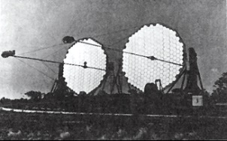
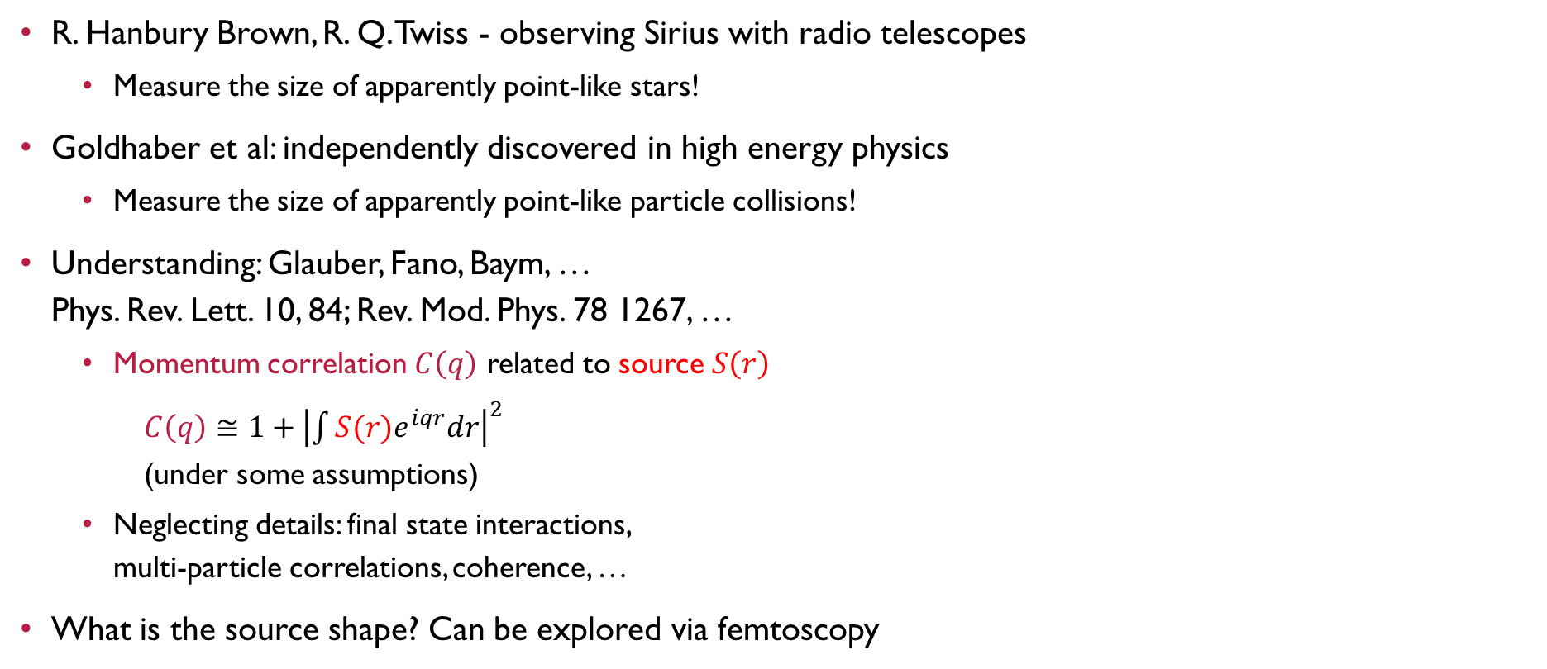
Femtoscopy in high energy physics
R. Hanbury Brown, R. Q. Twiss - observing Sirius with radio telescopes
  Measure the size of apparently point-like stars!
Goldhaber et al: independently discovered in high energy physics
  Measure the size of apparently point-like particle collisions!
Understanding: Glauber, Fano, Baym, …
Phys. Rev. Lett. 10, 84; Rev. Mod. Phys. 78 1267, …
  Momentum correlation $C\left(q\right)$ related to source $S\left(r\right)$
  $C\left(q\right)≅1+{\left|\int{S(r)e^{iqr}dr}\right|}^{2}$
  (under some assumptions)
  Neglecting details: final state interactions,
  multi-particle correlations, coherence, …
What is the source shape? Can be explored via femtoscopy
Correlation strength
~1/R
Detector distance
R
1/R
source function S(r)
correlation funct. C(q)
INTRODUCTION HIGH-ENERGY PHYSICS QUANTUM STATISTICS FEMTOSCOPY

Slide 26
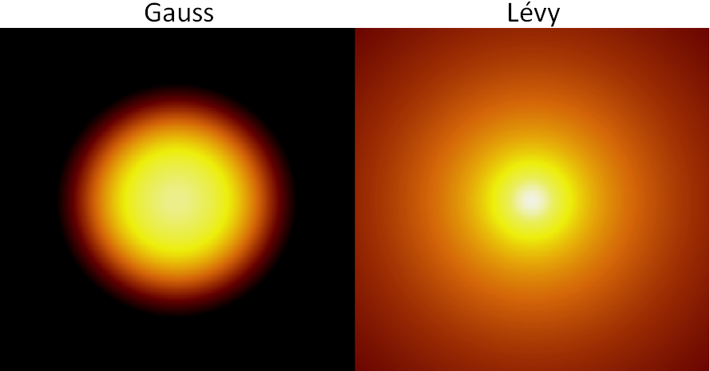
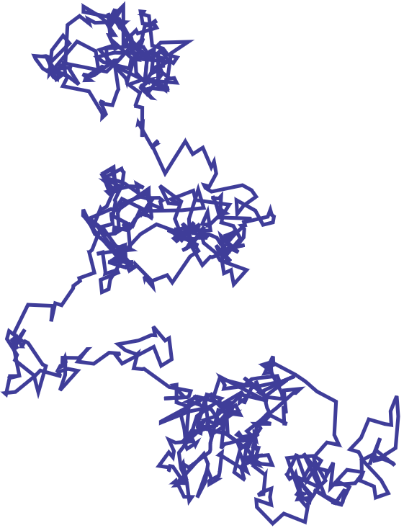
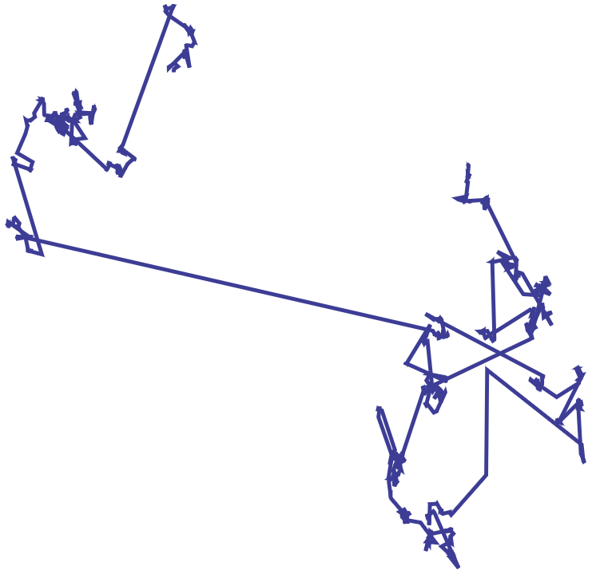
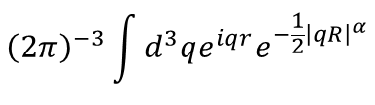
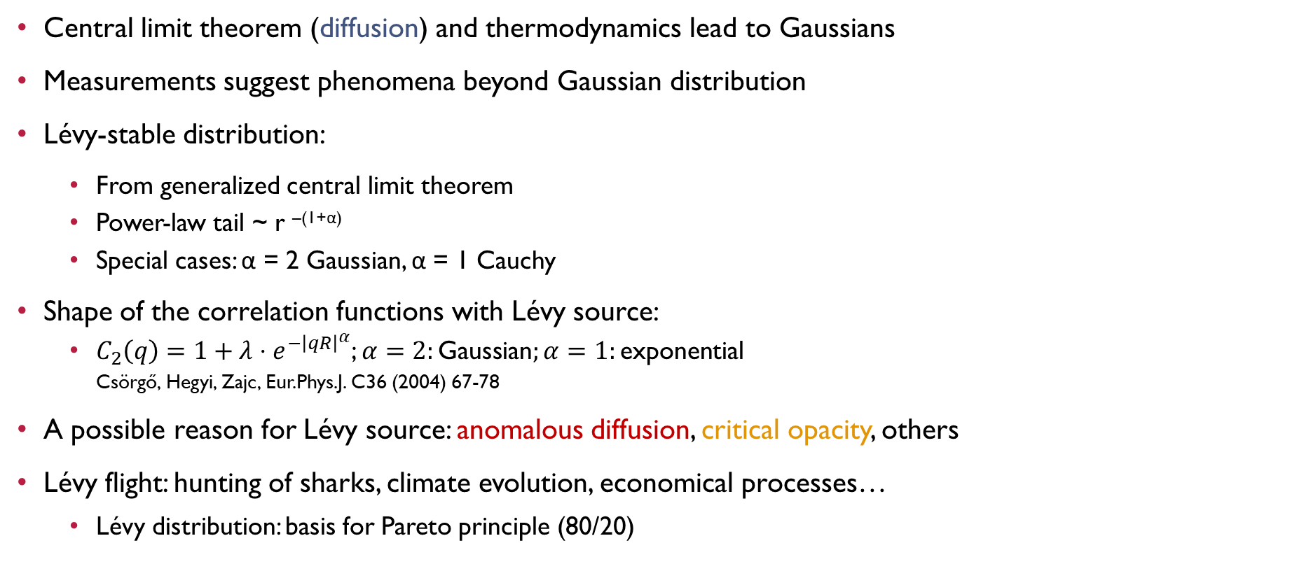
LÉvy distributions in heavy ion physics
Central limit theorem (diffusion) and thermodynamics lead to Gaussians
Measurements suggest phenomena beyond Gaussian distribution
Lévy-stable distribution:
  From generalized central limit theorem
  Power-law tail ~ r ^{–(1+α)}
  Special cases: α = 2 Gaussian, α = 1 Cauchy
Shape of the correlation functions with Lévy source:
  $C_{2}\left(q\right)=1+λ⋅e^{−{\left|qR\right|}^{α}}$; $α=2:\text{Gaussian};α=1:\text{e}\text{xponential}$
  Csörgő, Hegyi, Zajc, Eur.Phys.J. C36 (2004) 67-78
A possible reason for Lévy source: anomalous diffusion, critical opacity, others
Lévy flight: hunting of sharks, climate evolution, economical processes…
  Lévy distribution: basis for Pareto principle (80/20)
Normal diffusion
$${\left(2π\right)}^{−3}\int{d^{3}qe^{iqr}e^{−\frac{1}{2}{\left|qR\right|}^{α}}}$$
Gauss (α=2.0)
Lévy (α=1.2)
Anomalous diffusion (Lévy flight)
INTRODUCTION HIGH-ENERGY PHYSICS QUANTUM STATISTICS FEMTOSCOPY

Slide 27



Lévy index as a critical exponent?
Critical spatial correlation: $\sim r^{−\left(d−2+η\right)}$; Lévy source: $\sim r^{−\left(1+α\right)}$; $α⇔η$?
  Csörgő, Hegyi, Zajc, Eur.Phys.J. C36 (2004) 67
  Csörgő, Hegyi, Novák, Zajc, AIP Conf.Proc. 828
QCD universality class $↔$ 3D Ising
  Halasz et al., Phys.Rev.D58 (1998) 096007
  Stephanov et al., Phys.Rev.Lett.81 (1998) 4816
At the critical point:
  Random field 3D Ising: η = 0.50±0.05
  Rieger, Phys.Rev.B52 (1995) 6659
  3D Ising: η = 0.03631(3)
  El-Showk et al., J.Stat.Phys.157 (4-5): 869
Motivation for precise Lévy HBT!
Change in Lévy-index α in proximity of CEP?
Finite size/time & non-equilibrium effects $→$ what does power-law tail mean?
2.0
1.0
0.5
Lévy index of stability $α$
-0.5 0 0.5
$$(T−T_{c})/T_{c}$$
INTRODUCTION HIGH-ENERGY PHYSICS QUANTUM STATISTICS FEMTOSCOPY

Slide 28
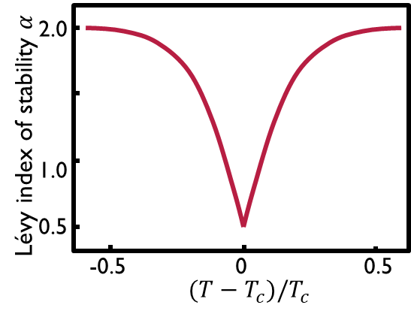


stability parameter $α$ from SPS to LHC
Final data
PHENIX: Phys.Rev.C 97 (2018) [arXiv:1709.05649]
CMS: Phys.Rev.C under review [arXiv:2306.11574]
NA61/SHINE: Eur.Phys.J.C accepted [arXiv:2302.04593]
Different values for small (Be+Be) & medium (Ar+Sc) systems at SPS
  Also true for Pb+Pb and p+p at LHC? (pp: $α=1$ assumed so far)
Medium and large systems: non-monotonic trend
  Final data in PHENIX, CMS and NA61/SHINE
  More preliminary results in PHENIX, STAR and NA61/SHINE
  e.g.: five papers in Universe vol. 9 (2023) no. 7
Compare to expectation cartoon based on
Csörgő, Hegyi, Zajc,
Eur.Phys.J. C36 (2004) 67
Non-monotonicity
to be expected?
NA61/SHINE
Ar+Sc
CMS
Pb+Pb
STAR
Au+Au
NA61/SHINE
Be+Be
PHENIX
Au+Au
$\sqrt{s_{NN}}$ [GeV]
INTRODUCTION HIGH-ENERGY PHYSICS QUANTUM STATISTICS FEMTOSCOPY

Slide 29

Summary
Goal of particle physics: understand forces & building blocks of the Universe
”Little bangs” in particle accelerators: recreate conditions after the Big Bang
  Initially extreme temperatures, protons, neutrons melt, quark matter created
  Explodes, cools down and „freezes out”, „frozen” particles detected
How to access the spacetime geometry? Via HBT correlations!
  HBT effect: intensity correlations due to quantum statistics
  Measuring the size of otherwise unresolvable objects
Femtoscopy: momentum correlations reveal femtometer scales
  Little bang geometry can be explored
  Lévy distributions observed
  Tool to understand the phase diagram
Lévy flight
INTRODUCTION HIGH-ENERGY PHYSICS QUANTUM STATISTICS FEMTOSCOPY

Slide 30


Thank you for your attention
And if you are
interested
in these topics:
: https://agenda.infn.it/event/33324/ http://zimanyischool.kfki.hu/23/

Slide 31
Backup slides

Slide 32

Timeline of a heavy ion collision
Pre-thermalization stage:
~1 fm/c
Quark-hadron transition:
~7-10 fm/c
Chemical + kinetic freeze-out
INTRODUCTION HIGH-ENERGY PHYSICS QUANTUM STATISTICS FEMTOSCOPY

Slide 33


Phases of nuclear/QCD matter
Phase diagram: state functions, phases (pressure ↔ density ↔ chemical potential)
Water and nuclear matter: similar phase diagrams
Theoretical calculations: above T_{c} ≈ 160 MeV ≈ 2 ∙10¹² K: quark matter created in heavy ion collisions
INTRODUCTION HIGH-ENERGY PHYSICS QUANTUM STATISTICS FEMTOSCOPY

Slide 34







What are the building blocks of matter?
Ancient history: four/five elements
1789: Dalton’s elements 33
1869: atoms, periodic system ~100
1930: proton, neutron, electron 3
1930-1960: „hadrons” ~100
1975: the Standard Modell 4
~2000: elemi részek sok altípusa ~100
Még elemibb részecskék? ??

Slide 35




Particle accelerators
$$\vec{E}$$
Fwd acceleration: electric field (voltage)
Circular orbit: magnetic field (focusing as well)
Cyclotron: acceleration between semicircles
Synchrotron: fixed orbit
$$\vec{B}$$
cyclotron
INTRODUCTION EXPERIMENTS OBSERVATIONS

Slide 36


Particle detectors
Bubble chamber: overheated fluid, bubble creation
image reveals particle tracks
Cloud chamber: supersaturated gas,
condensation, tracks visible
Ionization detector: traversing particle
ionizes gas, electronical tracking
Scintillator: luminescence, light detection
Semiconductor detectors:
similar to CCD chip
Many Nobel prizes:
Wilson, Glaser, Charpak
INTRODUCTION EXPERIMENTS OBSERVATIONS

Slide 37




Known mesons and baryons
Octet/nonet/decuplet
Triangular symmetry
Revealing flavor SU(3)
for u,d,s quarks
Each hadron is a representation
Other possible states:
  Tetraquark
  Pentaquark
  Glueball
  Meson molecules
INTRODUCTION EXPERIMENTS OBSERVATIONS

Slide 38
Time evolution of a heavy ion collision
γ, e±, μ±
γ, e±, μ±
π±, K±, p, ..
π±, K±, p, ..
Hadron gas
Initial stage:
  Hard scattering
  Jet formation
Leptons, photons:
  ”shine through”
Hadrons:
  Dissociation and coalescence
  ”Final” hadrons created at freeze-out
How do we know if sQGP
was there or not?
Freeze-out, hadrons
jets
sQGP
INTRODUCTION EXPERIMENTS OBSERVATIONS

Slide 39



Collisions of different centrality
Centrality: how head-on the collision was
Measure: how many events are more central?
  0%: most central collision; 0-5%: most central 1/20th of all; 90-100%: least central 1/10th of all
Central
Peripheral
INTRODUCTION EXPERIMENTS OBSERVATIONS

Slide 40

RHIC recorded runs and Luminosity

Slide 41



Research groups @ ELTE
LHC, RHIC: ELTE participates in cutting-edge experiments
Theory: field theories, hydrodynamics, femtoscopy, …
All possible from Budapest
Some visints are necessary though…

Slide 42



CERN, LHC and SUrroundings
Mont Blanc
Geneve
Lake Geneva
Swiss-French border
CERN
INTRODUCTION EXPERIMENTS OBSERVATIONS

Slide 43


LHC in Numbers
2x27 km, 150-200 m deep
Collisions: 4 intersections
~3000 bunches
99.9999991% speed of light
10 000 rounds/sec
600 million collisions/sec
10 000 superconducting magnets
10 000 tons of liquid N₂: 80 K
120 tons of liquid He: 2 K
120 MW electricity consumption (c.f. a large city)
6 μg H⁺ in 10 years
25 000 terabyte data yearly
INTRODUCTION EXPERIMENTS OBSERVATIONS

Slide 44

Areal Photo of RHIC
INTRODUCTION EXPERIMENTS OBSERVATIONS

Slide 45




RHIC in Numbers
Two rings, 4 km each
99.995% speed of light
111 bunches
80 000 rounds/sec
Thousands of collisions/sec
1740 superconducting magnets
21 000 km superconducting wires
25 tons of liquid He
0.00005 mg gold/year
INTRODUCTION EXPERIMENTS OBSERVATIONS

Slide 46



STAR: upgrades and fixed target program
Large acceptance, great PID capabilities: great for identified hadrons
Upgrades for BES-II
  innerTPC: better dE/dx (PID) and mom. res.
  Event Plane Detector: replace BBC,
  better triggering & EP resolution
  Endcap TOF: extended fwd PID
Fixed target program: to reach lower energies
  1 cm wide, 1mm thick target at 2.1 m
  Collider: $\sqrt{s_{NN}}=E_{beam}+E_{beam}$
  Fixed target: $\sqrt{s_{NN}}=\sqrt{2⋅M_{p}⋅E_{beam}}$ ($E_{beam}$: per nucleon)
  At the lowest energies: out to $μ_{B}>700$ MeV
a 3.9 GeV event

Slide 47


Collisions in CMS at the LHC
Collisions in the center
Various types
of detectors
Layered structure
Size of a multi-story house

Slide 48


collision in STAR & PHENIX at RHIC

Slide 49

PHENIX and sPHENIX
PHENIX: versatile detector identifying many different particles, recording large amount of collisions. Dismantled in 2016, to give way to sPHENIX
sPHENIX: to take data in ~2023
  Jets, jet correlations, Upsilon states
  EM+Hadronic calorimetry, high resolution tracking, fast (~100 kHz) data aquisition
PHENIX
2012
sPHENIX
2022
INTRODUCTION EXPERIMENTS OBSERVATIONS

Slide 50


(FUTURE) FacilitIES comparison
Many future facilities and experiments,
SPS and RHIC already running
RHIC, NICA: Collider and fixed target
SPS, FAIR, J-PARC: fixed target
Energy ranges from 2 to 20 GeV in $\sqrt{s_{NN}}$
Facility | RHIC BES-II & Fixed Target | SPS | NICA | FAIR | J-PARC HI
Experiment | STAR | NA61 | MPD & BM@N | CBM | JHITS
Start | 2019 | 2009 | 2020-23 | 2025 | 2025
Energy ($\sqrt{s_{NN}}$, GeV) | 2.9-19.6 GeV | 4.9-17.3 | 2.0-11 | 2.7-8.2 | 2.0-6.2
Rate | 100-1000 Hz | 100 Hz | 10 kHz | 10 MHz | 10-100 MHz
Physics | Critical Point Onset of Deconf. | Critical Point Onset of Deconf. | Onset of Deconfinement Compr. Hadronic Matter | Onset of Deconfinement Compr. Hadronic Matter | Onset of Deconfinement Compr. Hadronic Matter

Slide 51


Hydro behavior
Collision (participant) zone: almond shape (ellipsoid)
Residual (spectator) nucleons: continue flight
Created medium: collision-like expansion
If fluid: pressure anisotropy → expansion asymmetry
quark matter
spectator
nucleons
INTRODUCTION EXPERIMENTS OBSERVATIONS

Slide 52

Hydro behavior
Distributions of observed hadrons: proves hydro behavior
Timescale of the above plot: fm/c, time of light to traverse a proton
Gas: free streaming; Fluid: strong interactions
gas
fluid
INTRODUCTION EXPERIMENTS OBSERVATIONS

Slide 53



VISCOSITYof the sQGP
Viscosity/entropy density: proportional to mean free path
Strong coupling: small $η/s$
AdS_{D+1}/CFT_{D} lower bound: $\frac{η}{s}≥\frac{ℏ}{4π}$
  Malcadena et al.: Adv.Theor.Math.Phys.2:231-252,1998
  Kovtun et al.: Phys.Rev.Lett. 94 (2005) 111601
Measurement and calculation results:
  R. Lacey et al., Phys.Rev.Lett.98:092301,2007
  H.-J. Drescher et al., Phys.Rev.C76:024905,2007
  S. Gavin, M. Abdel-Aziz, Phys.Rev.Lett.97(2006)162302
  A. Adare et al. (PHENIX), PRL98:172301,2007
INTRODUCTION EXPERIMENTS OBSERVATIONS

Slide 54

The perfect liquid
Viscosity: appearance of shear stress/force
Viscosity of the sQGP: nearly zero
perfect
viscous
INTRODUCTION EXPERIMENTS OBSERVATIONS

Slide 55





heavy flavor suppression & regeneration
Timeline: quarkonium ($\text{q}\overline{\text{q}}$) formation $→$ QGP evolution $→$ $\text{q}\overline{\text{q}}$ decay
Quarkonia experience the whole QGP evolution, competing processes
Suppression due to color-screening: temperature and size/mass dependence
Statistical
regeneration
in time:
Images from J Castillo, SQM17 and A Mócsy, HardProbes2009
INTRODUCTION EXPERIMENTS OBSERVATIONS

Slide 56


Higher order anisotropies
Created medium is ~ellipsoidal on average
  With respect to event plane
In reality: finite number of nucleons
Single event: fluctuating
location of nucleons
Fluctuating shape of initial fireball
Various orders of planes defined
  $\tan{Ψ_{n}}=\frac{Σ\sin{nφ_{i}}}{Σ\cos{nφ_{i}}}$
Eccentricity of various orders
Higher order: washed out by viscosity
If still present: low viscosity
φ

Slide 57


Experimental Control parameters
Collision energy: controls initial temperature, initial μ_{B}
Collision system & centrality: controls available volume
Event geometry: reaction plane, event plane, fluctuations
Important parameters: N_{part} (system size), N_{coll} (x-sect)
Central Au+Au
N_{part}~300
Peripheral Au+Au
N_{part}~50
d+Au
p+p
Reality
Multipole event planes
Reaction Plane
INTRODUCTION EXPERIMENTS OBSERVATIONS

Slide 58




Important kinematic quantities
Particle four-momentum: $p=(E,p_{x},p_{y},p_{z})$
Beam direction: z; transverse plane: perpendicular to z: (x,y) coordinates
Transverse momentum: $p_{T}=\sqrt{p_{x}^{2}+p_{y}^{2}}$; transverse mass: $m_{T}=\sqrt{m^{2}+p_{T}^{2}}$
Spherical coordinates:
$p_{x}=p_{T}\cos{φ}$, $p_{y}=p_{T}\sin{φ}{}_{z}$
$p_{T}=\left|p\right|\sin{θ}$, $p_{z}=\left|p\right|\cos{θ}$
Rapidity:
$y=0.5\ln{\frac{E+p_{z}}{E−p_{z}}}=\operatorname{atanh}{\frac{p_{z}}{E}}$
Pseudorapidity:
$η=0.5\ln{\frac{\left|p\right|+p_{z}}{\left|p\right|−p_{z}}}=−\ln{\operatorname{tg}{\frac{θ}{2}}}$
$$p_{T}$$
$$θ$$
beam: z axis
transverse plane
$$p_{z}$$

Slide 59


QGP signatures Expectations, 1996
Critical energy density: $ε_{c}≈1 \text{GeV}/{\text{fm}}^{3}$, temperature $T_{c}≈170 MeV$
Some observed, some not…
J. Harris & B. Mueller, „The Search for the QGP”, Ann.Rev.Nucl.Part.Sci. 46 (1996) 71 [hep-ph/9602235]
INTRODUCTION EXPERIMENTS OBSERVATIONS

Slide 60
Nuclear modification: tomography!
nucleus+nucleus
proton+proton
Simply just more?
A+A = many p+p?
High p_{T} particle yield in A+A
R_{AA}=
High p_{T} particle yield in p+p
×
Number of p+p collisions
If R_{AA}≠1: sign of nuclear modification
INTRODUCTION EXPERIMENTS OBSERVATIONS

Slide 61










Suppression as a function of centrality
No suppression in d+Au or peripheral Au+Au; strong suppression in central!
Phys.Rev.C76:034904,2007
Enhanced
Suppressed
INTRODUCTION EXPERIMENTS OBSERVATIONS

Slide 62


Control experiment: d+Au collisions
Suppression in Au+Au collisions: 1st milestone
Lack of suppression in d+Au: 2nd milestone
Two PRL covers
Au+Au
d+Au
Zajc, Riordan, Scientific American
INTRODUCTION EXPERIMENTS OBSERVATIONS

Slide 63

Suppression of the away side jet
Angular correlation of high energy hadrons
Outgoing jet: similar in p+p, d+Au, Au+Au
Inward going (away side) jet: missing in central Au+Au
PRL91(2003)072304
pedestal and flow subtracted
INTRODUCTION EXPERIMENTS OBSERVATIONS

Slide 64



How do other particles behave?
All hadrons suppressed, after 4-6 GeV/c transverse momentum
Direct photons „shine through”
Suppression dependent of system size (controlled by centrality or N_{part})
PHENIX Au+Au $\sqrt{s_{NN}}$=200 GeV
Phys.Rev.Lett. 94 (2005) 232301
INTRODUCTION EXPERIMENTS OBSERVATIONS

Slide 65

Strongly interacting medium
Collsion → extremely energetic colored particles, jets
Nucleus-sized medium: slows down jets
Does not affect photons: strongly interacting matter!
Comparision of suppression strength:
  Gamma radiation in lead: few cm distance
  Alpha radiation in water: 0.001 cm distance
  Jets in quark matter: 0.0000000000001 cm
collision side-view
collision side-view frontal view
nucleus
nucleus
proton
proton
jet-pair
photons
quark matter: slows jets down
INTRODUCTION EXPERIMENTS OBSERVATIONS

Slide 66

Hydrodynamical scaling
Large cross-sections, many collisions, early thermalization
Thermalization timescale: ~1 fm/c
Measured hadron spectra Boltzmannian: exp(-E/T_{eff})
Effective temperature:
T_{eff}: due to expansion
≠ temperature
Simple hydro model:
T_{eff} = T + m∙u²
Experimental confirmation
General observation:
thermalization & hydro
creates scaling
INTRODUCTION EXPERIMENTS OBSERVATIONS

Slide 67

Observation of the elliptic flow
Initial spatial anisotropy creates
momentum-space anisotropy!
Quantified via
anisotropy
parameters
Zajc, Riordan, Scientific American
φ
$$f\left(φ\right)=1+2\sum_{n}{v_{n}\cos{nφ}}$$
ϕ
0 π 2π
INTRODUCTION EXPERIMENTS OBSERVATIONS

Slide 68


Elliptic flow measurements vs theory
Elliptic flow ($v_{2}$) nonzero $⇒$ collective effect
  Initial spatial anisotropy turning into
  final state momentum anisotropy
Concrete measured values:
can be described by hydro models
  In this case, the Buda-Lund model
  Csanád, Csörgő, Lörstad, Nucl.Phys.A 742 (2004) 80
Data and hydro match up to ~2 GeV
Above that, hard processes, jets
dominate results
  To be described by perturbative QCD

Slide 69


The most vortical fluid
Measurement: polarization of
baryons observable
Reason: vorticity
Most vortical fluid ever seen
INTRODUCTION EXPERIMENTS OBSERVATIONS

Slide 70

Quark degrees of freedom
Scaling of elliptic flow, when measured versus transverse kinetic energy (KE_{T})
Different particle types: scaling curve depends on valence quark content (n_{q})
Reason: coalescence
Scaling: v₂/n_{q} versus KE_{T}/n_{q}, baryons = mesons
Phys.Rev.Letters 98:162301, 2007
baryons
mesons
INTRODUCTION EXPERIMENTS OBSERVATIONS

Slide 71


Thermal photons
Thermal photons
Hadron creation: after freeze-out
Direct vs decay photons measured
Soft component in direct photon spectra:
compared to p+p extrapolation
These are thermal photons!
Large initial temperature, 3-600 MeV!
Direct photon spectrum
Prediction based on pp
photons
hadrons
nucleon-nucleon
proton-proton
PRC 91,064904
Transverse momentum [GeV]
INTRODUCTION EXPERIMENTS OBSERVATIONS

Slide 72



Freeze-out curve from particle yields
Chemical and kinetic freeze-out parameters via THERMUS and BlastWave
Thermal multiplicity assumption valid
Systematics investigated (parameter constraints, included species)
Separation of T_{ch} and T_{kin} around $\sqrt{s_{NN}}=$4-5 GeV, T_{ch} flattens at ~10 GeV
STAR Collaboration, Phys. Rev. C 96, 044904 (2017) [arXiv:1701.07065]
INTRODUCTION EXPERIMENTS OBSERVATIONS

Slide 73



Search for the Critical Point possible?
Effects of the CEP in a broad region (via an effective potential ~ N_{f}=2 QCD)
  Y. Hatta and T. Ikeda, PRD67,014028(2003) [hep-ph/0210284]
Hydro evolution attracted to the critical point
  M. Asakawa et al., PRL101,122302(2008) [arXiv:0803.2449]
quark number susceptibility
Tricrit.Point (chiral limit)
$→$ Critical Point
$→$ Cross-Over
$→$ First Order
CEP
INTRODUCTION EXPERIMENTS OBSERVATIONS

Slide 74





Search for the CEp: Fluctuations
Static universality class: 3D Ising (or random field 3D Ising?)
Dynamic universality class? 1 or 3 slow modes? Finite size/time effects?
Look at cumulants: $C_{n}=\left\langle {\left(n−\left\langle n\right\rangle \right)}^{n}\right\rangle$, function of corr. length $ξ\sim {\left|T−T_{c}\right|}^{−ν}$
$C_{n}\sim ξ^{2.5n−3}$ $\left(C_{2}\sim ξ^{2},C_{3}\sim ξ^{4.5},C_{4}\sim ξ^{7}\right)$
Non-monotonicity at CEP:
Usual observables:
$$\frac{M}{σ^{2}}=\frac{C_{1}}{C_{2}}, Sσ=\frac{C_{3}}{C_{2}}, κσ^{2}=\frac{C_{4}}{C_{2}}$$
Finite size effects dampen
divergencies in $ξ$!
Stephanov, IJMPA20,4387(2005)
Stephanov, PRL102, 032301(2009)
Stephanov, PRL107, 052301(2011)
Asakawa et al., PRL103, 262301(2009)
Hatta et al., PRL91,102003(2003)
$$\frac{C_{4}}{C_{2}}$$
$$T$$
STAR, PRL113(2014)092301
STAR, PRL112(2014)032302
INTRODUCTION EXPERIMENTS OBSERVATIONS

Slide 75

Search for the CEP, finite size/time effects
Finite size limits correlation length: $ξ\sim {\left|T−T_{c}\right|}^{−ν}$ but $ξ<L$!
Only a pseudocritical point can be observed
Clear influence on the phase diagram
Convenient situation: finite size scaling
discloses CEP location
and universality class
  Shift: $\sim L^{−1/ν}$
  Broadening: $\sim L^{−1/ν}$
  Dampening: $\sim L^{−γ/ν}$
T>T_{c}
T near T_{c}
INTRODUCTION EXPERIMENTS OBSERVATIONS

Slide 76



HBT and the phase transition
C(q) usually measured in the Bertsch-Pratt pair coordinate-system
  out: direction of the average transverse momentum
  long: beam direction
  side: orthogonal to the latter two
R_{out}, R_{side}, R_{long} : HBT radii
Out-side difference → ∆τ emission duration
From a simple hydro calculation:
$R_{out}^{2}=\frac{R^{2}}{1+u_{T}^{2}m_{T}/T_{0}}+β_{T}^{2}Δτ^{2}$, $R_{side}^{2}=\frac{R^{2}}{1+u_{T}^{2}m_{T}/T_{0}}$
RHIC, 200 GeV: $R_{out}≈R_{side}$→ no strong 1st order phase trans.
Plus, lots of other details: pre-equilibrium flow, initial state, EoS, ...
S. Chapman, P. Scotto, U. Heinz, Phys.Rev.Lett. 74 (1995) 4400
T. Csörgő and B. Lörstad, Phys.Rev. C54 (1996) 1390
S. Pratt, Nucl.Phys. A830 (2009) 51C
$$\frac{R_{out}}{R_{side}}≫1$$
out
side

