Slide 1
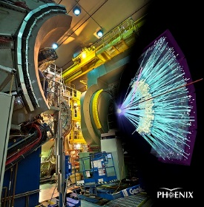
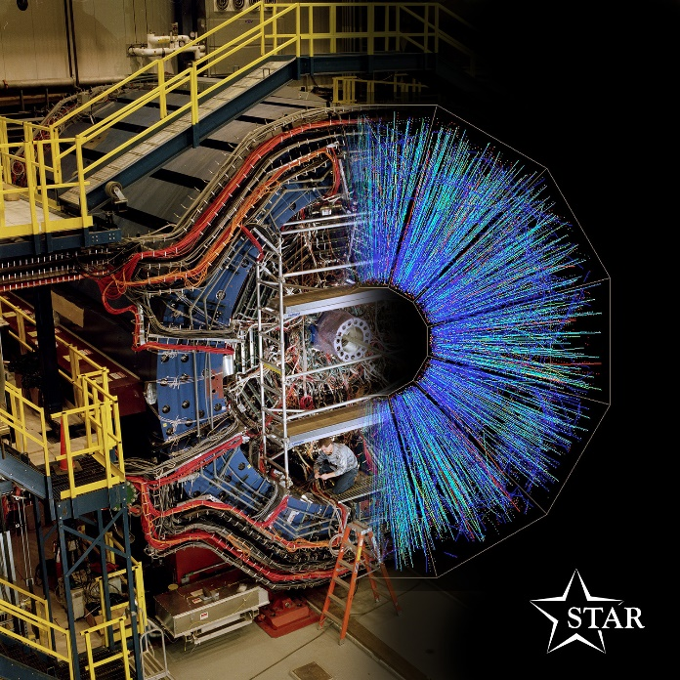

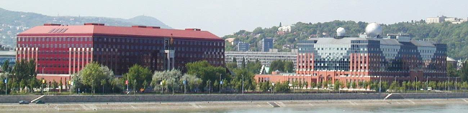
The RHIC+SPS+FAIR+NICA+JPARC
Beam Energy SCAN Program with special focus on HBT
Máté Csanád
Eötvös University, Budapest, Hungary

Slide 2
Content of this talk
INTRODUCTION
  The Big Bang and the Little Bangs in the lab
  Phase map of QCD and the experimental control parameters
  High energy physics facilities, experiments
BASIC OBSERVATIONS
  Nuclear modification, flow, thermal photons, heavy flavor, HBT, fluctuations
RECENT BES RESULTS FROM RHIC
  Freeze-out curve known
  Nuclear modification, flow, thermal photons, heavy flavor behavior
  Correlations: finite size scaling in HBT measurements, intermittency at SPS
LÉVY HBT
  Search for and characterization of the Critical EndPoint (if any)
INTRODUCTION BASIC OBSERVATIONS RECENT BES RESULTS LÉVY HBT

Slide 3
INTRODUCTION
Universe history, Big Bang and Little Bangs
Time evolution of heavy ion collisions
Phase map of QCD
Experimental control parameters
Experiments, recorded data
INTRODUCTION BASIC OBSERVATIONS RECENT BES RESULTS LÉVY HBT

Slide 4
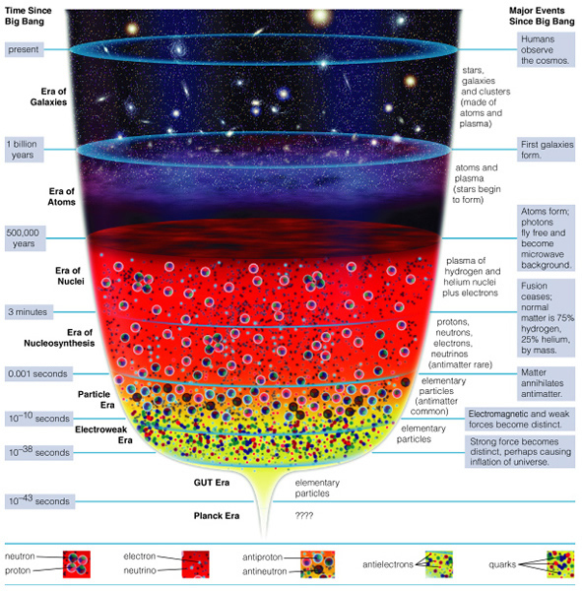
Big Bang in the lab
Ages of the Universe:
  Stars & Galaxies
  Atoms
  Nuclei
  Nucleosynthesis
  Elementary particles
  … ?
How to investigate?
Create little bangs
Collisions of heavy ions
Record outcoming particles
INTRODUCTION BASIC OBSERVATIONS RECENT BES RESULTS LÉVY HBT

Slide 5
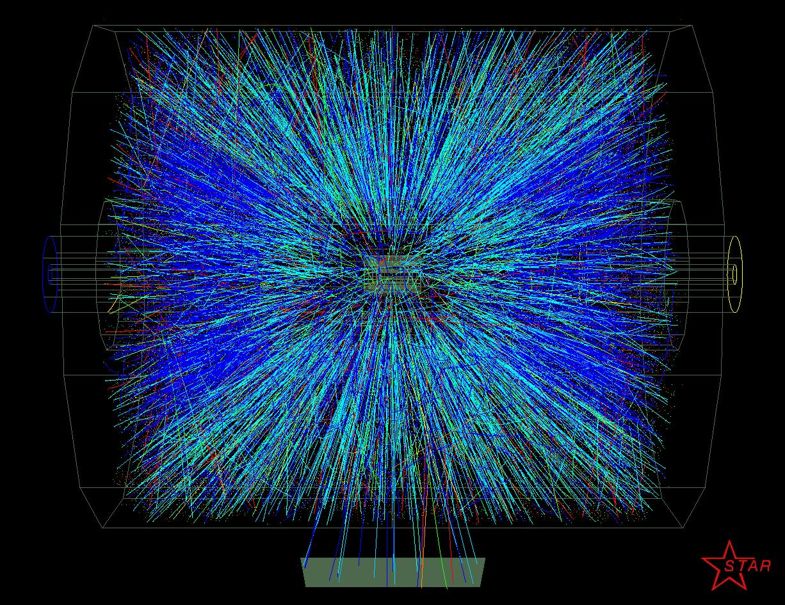
How to investigate these little bangs?
INTRODUCTION BASIC OBSERVATIONS RECENT BES RESULTS LÉVY HBT

Slide 6
Time evolution of a heavy ion collision
γ, e±, μ±
γ, e±, μ±
π±, K±, p, ..
π±, K±, p, ..
Hadron gas
Initial stage:
  Hard scattering
  Jet formation
Leptons, photons:
  ”shine through”
Hadrons:
  Dissociation and coalescence
  ”Final” hadrons created at freeze-out
How do we know if sQGP
was there or not?
Freeze-out, hadrons
jets
sQGP
INTRODUCTION BASIC OBSERVATIONS RECENT BES RESULTS LÉVY HBT

Slide 7
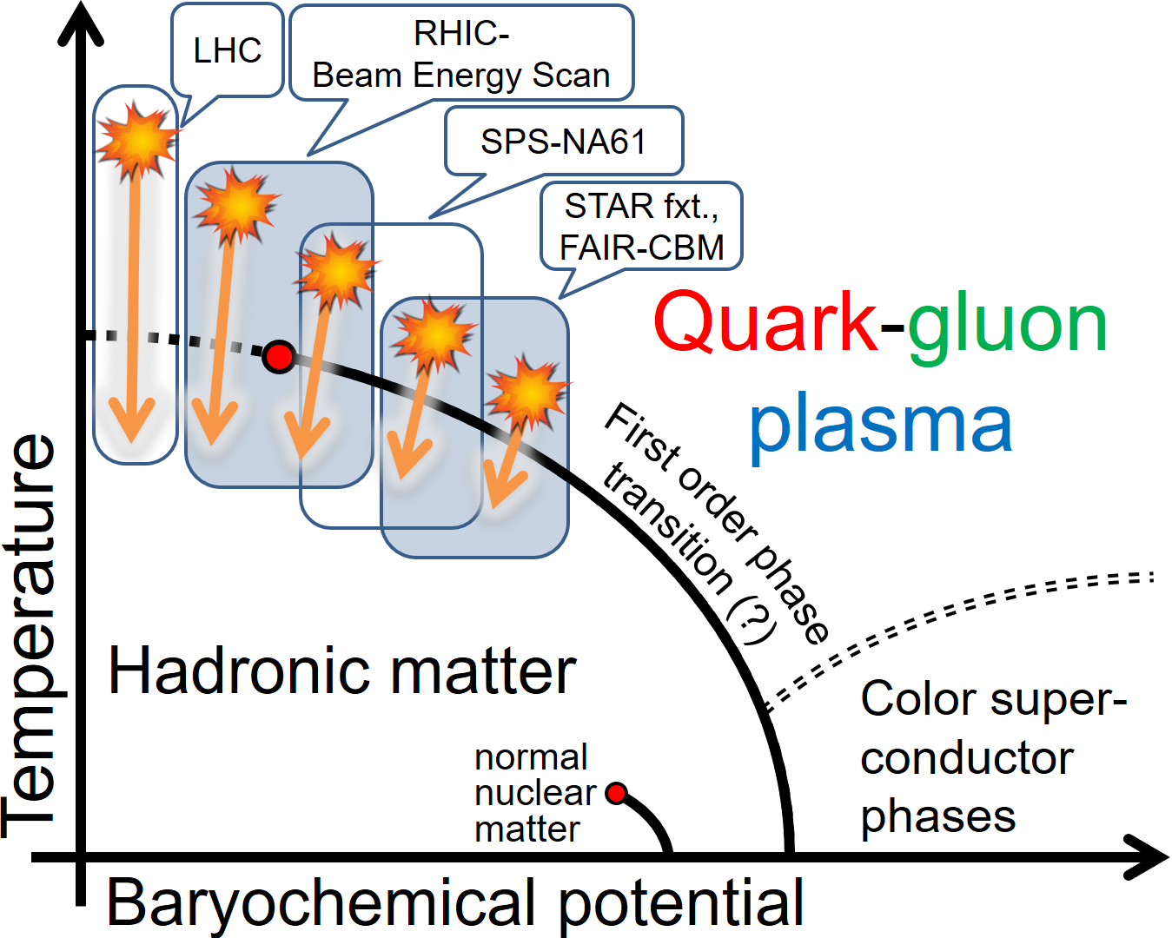
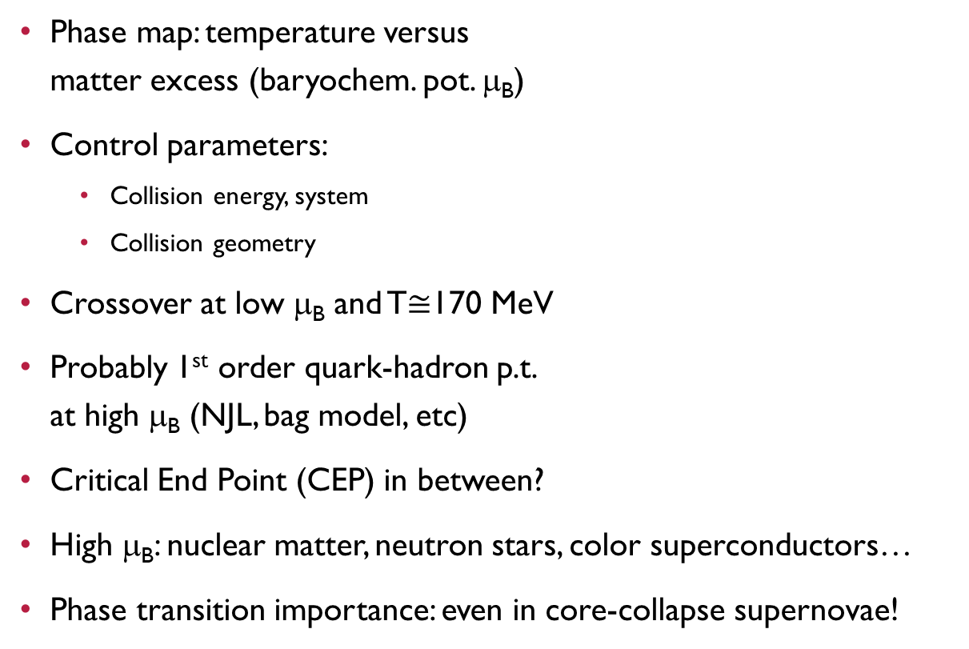
Exploring the Phase map of QCD
Phase map: temperature versus
matter excess (baryochem. pot. μ_{B})
Control parameters:
  Collision energy, system
  Collision geometry
Crossover at low μ_{B} and T$≅$170 MeV
Probably 1st order quark-hadron p.t.
at high μ_{B} (NJL, bag model, etc)
Critical End Point (CEP) in between?
High μ_{B}: nuclear matter, neutron stars, color superconductors…
Phase transition importance: even in core-collapse supernovae!
+J-PARC HI
+NICA
INTRODUCTION BASIC OBSERVATIONS RECENT BES RESULTS LÉVY HBT

Slide 8
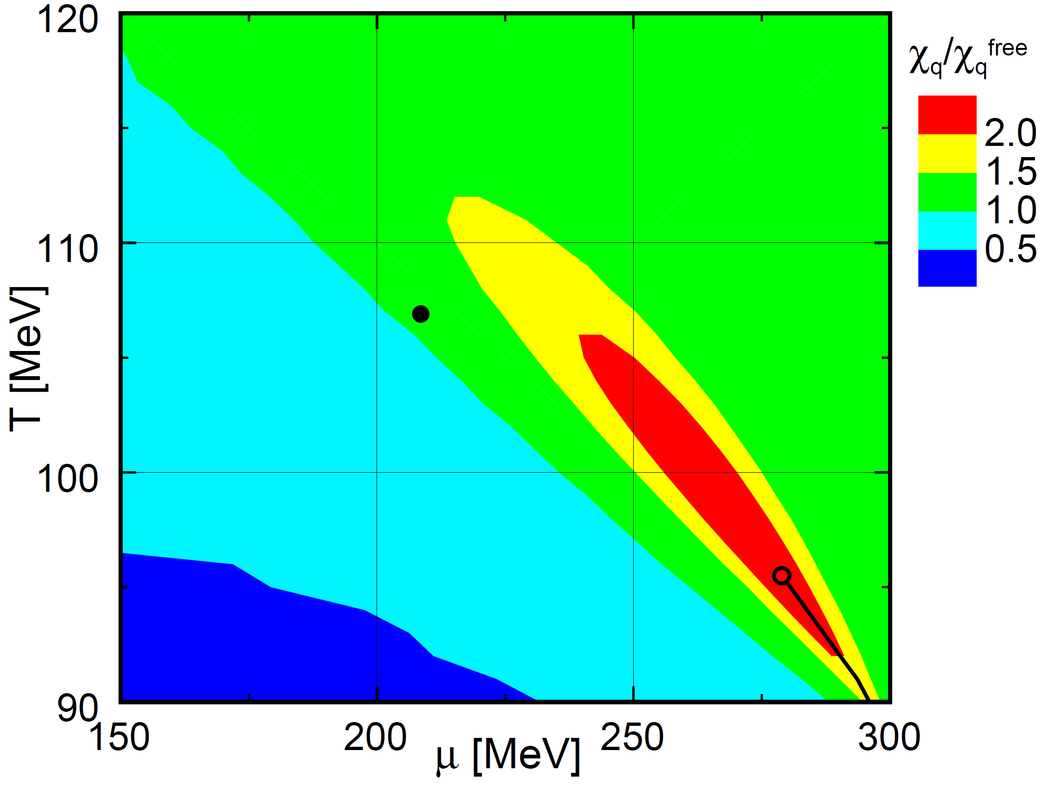
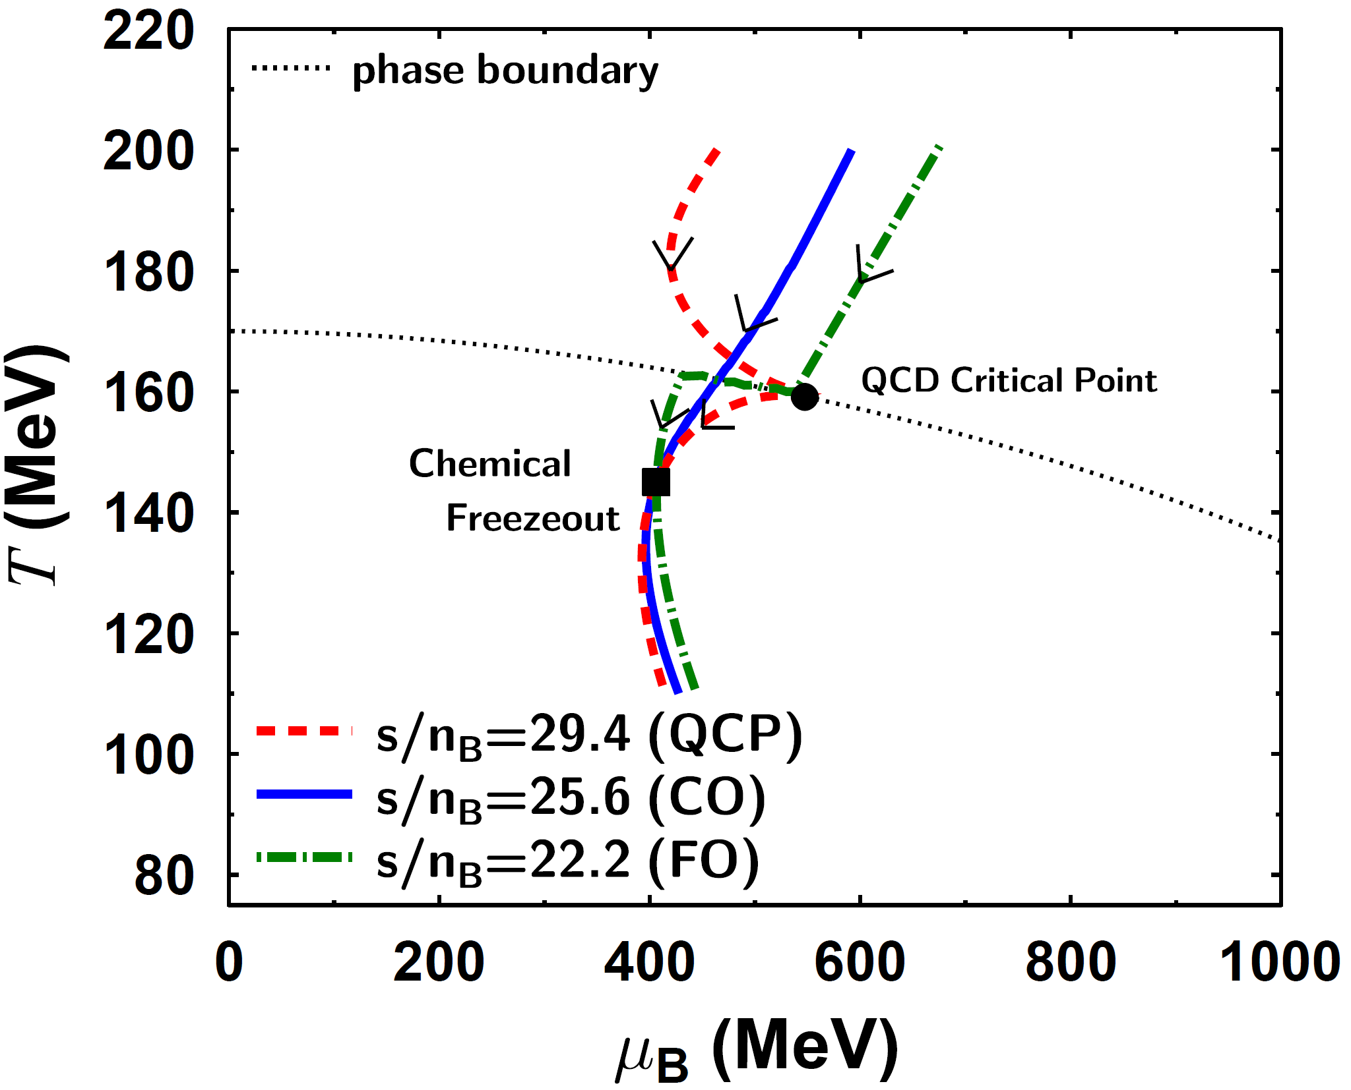

Search for the Critical Point possible?
Effects of the CEP in a broad region (via an effective potential ~ N_{f}=2 QCD)
  Y. Hatta and T. Ikeda, PRD67,014028(2003) [hep-ph/0210284]
Hydro evolution attracted to the critical point
  M. Asakawa et al., PRL101,122302(2008) [arXiv:0803.2449]
quark number susceptibility
Tricrit.Point (chiral limit)
$→$ Critical Point
$→$ Cross-Over
$→$ First Order
CEP
INTRODUCTION BASIC OBSERVATIONS RECENT BES RESULTS LÉVY HBT

Slide 9
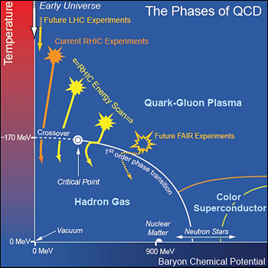
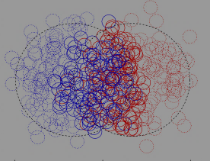
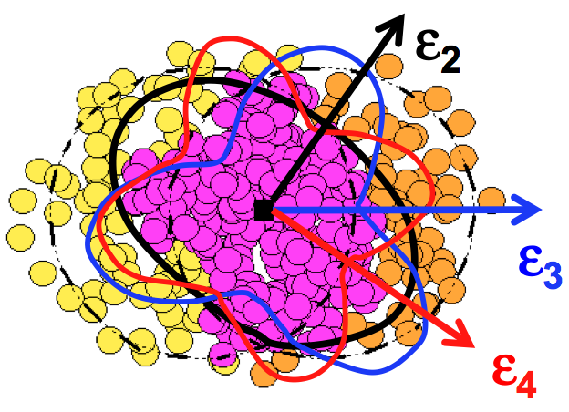
Experimental Control parameters
Collision energy: controls initial temperature, initial μ_{B}
Collision system & centrality: controls available volume
Event geometry: reaction plane, event plane, fluctuations
Important parameters: N_{part} (system size), N_{coll} (x-sect)
Central Au+Au
N_{part}~300
Peripheral Au+Au
N_{part}~50
d+Au
p+p
Reality
Multipole event planes
Reaction Plane
INTRODUCTION BASIC OBSERVATIONS RECENT BES RESULTS LÉVY HBT

Slide 10
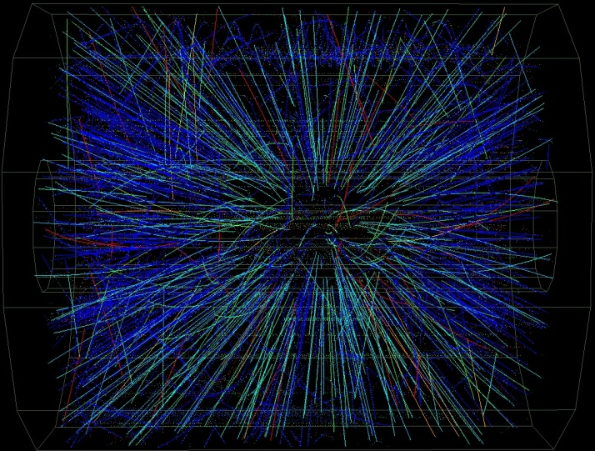
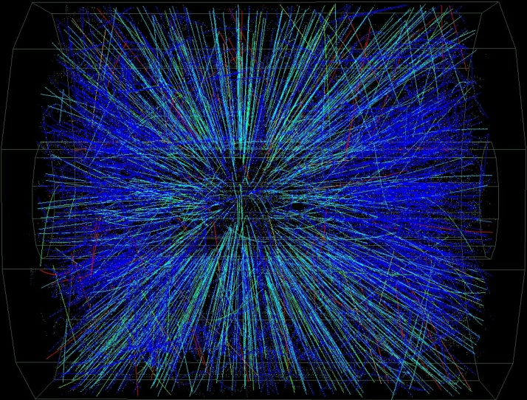
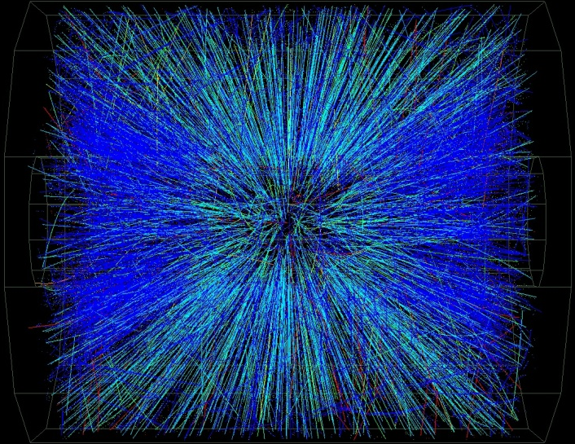
Collisions of different centrality
Peripheral
Central
INTRODUCTION BASIC OBSERVATIONS RECENT BES RESULTS LÉVY HBT

Slide 11
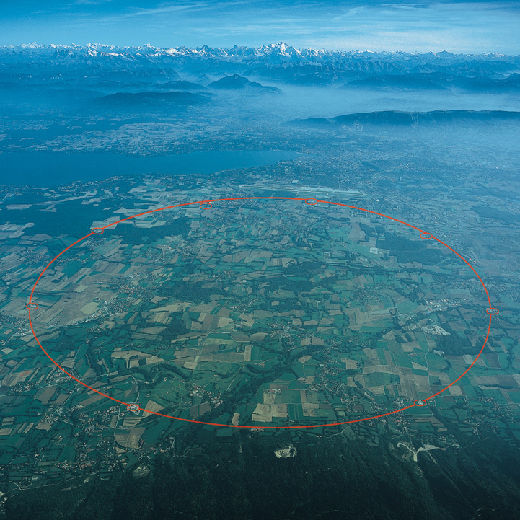
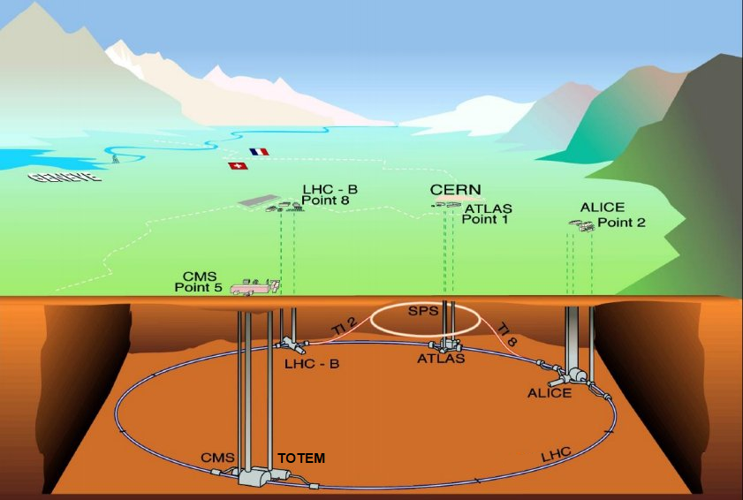
Facilities: Large Hadron Collider (+SPS)
LHC collisions: p+p, p+Pb and Pb+Pb
Energies: from 2.76 TeV/nucleon to 13 TeV (p+p only)
Experiments: ALICE, ATLAS, CMS, LHCb, LHCf, MoEDAL, TOTEM
Phase diagram related studies: SPS (NA61/SHINE, previously NA49)
INTRODUCTION BASIC OBSERVATIONS RECENT BES RESULTS LÉVY HBT

Slide 12
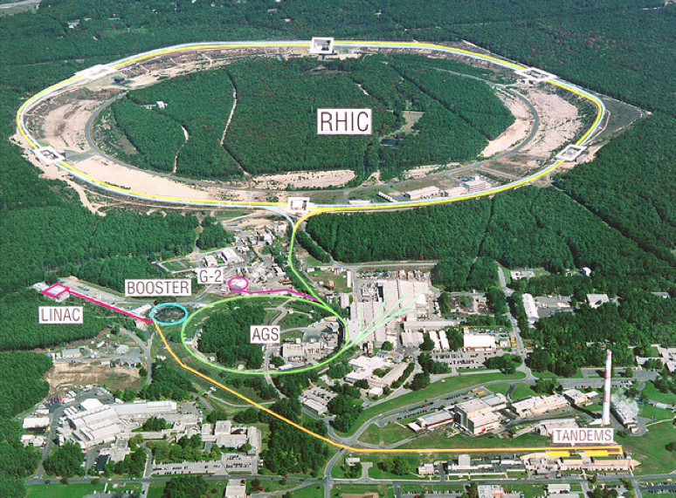


The Relativistic Heavy Ion Collider
At the Brookhaven National Laboratory, Long Island, New York, USA
Collisions of: $\vec{\text{p}}$, d, ³He, Al, Cu, Au, U
Accelerator energies: 7.7-200 GeV/nucleon, even 0.51 TeV for $\vec{\text{p}}$
Experiments: STAR; future: sPHENIX; past: BRAHMS & PHOBOS & PHENIX
INTRODUCTION BASIC OBSERVATIONS RECENT BES RESULTS LÉVY HBT

Slide 13
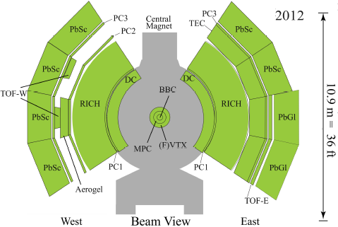
PHENIX and sPHENIX
PHENIX: versatile detector identifying many different particles, recording large amount of collisions. Dismantled in 2016, to give way to sPHENIX
sPHENIX: to take data in ~2023
  Jets, jet correlations, Upsilon states
  EM+Hadronic calorimetry, high resolution tracking, fast (~100 kHz) data aquisition
PHENIX
2012
sPHENIX
2022
INTRODUCTION BASIC OBSERVATIONS RECENT BES RESULTS LÉVY HBT

Slide 14
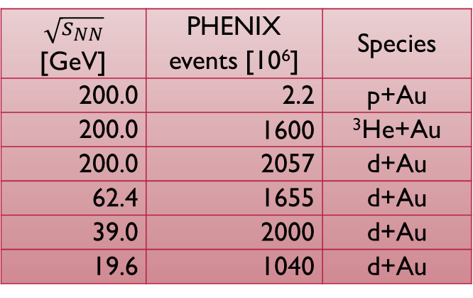
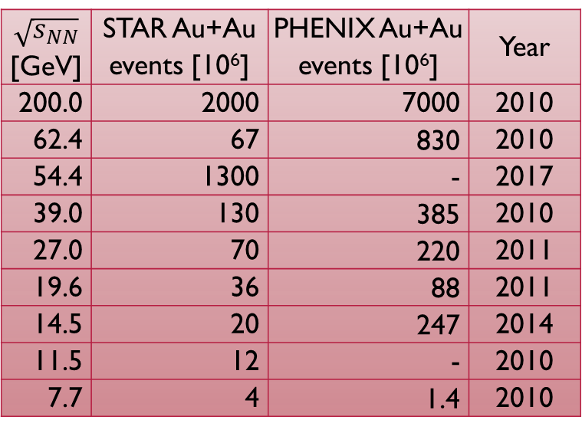
the RHIC Beam Energy/SPECIES scan
Collision experiments: acceptance independent of energy
BES-I: 7.7-200 GeV; BES-II: 7.7-19.9 GeV, increased luminosity
Small system scan: x+Au, 19.6-200 GeV
STAR fixed target mode: down to 3 GeV
$\sqrt{s_{NN}}$ [GeV] | STAR Au+Au events [10⁶] | PHENIX Au+Au events [10⁶] | Year
200.0 | 2000 | 7000 | 2010
62.4 | 67 | 830 | 2010
54.4 | 1300 | - | 2017
39.0 | 130 | 385 | 2010
27.0 | 70 | 220 | 2011
19.6 | 36 | 88 | 2011
14.5 | 20 | 247 | 2014
11.5 | 12 | - | 2010
7.7 | 4 | 1.4 | 2010
$\sqrt{s_{NN}}$ [GeV] | PHENIX events [10⁶] | Species
200.0 | 2.2 | p+Au
200.0 | 1600 | ³He+Au
200.0 | 2057 | d+Au
62.4 | 1655 | d+Au
39.0 | 2000 | d+Au
19.6 | 1040 | d+Au
INTRODUCTION BASIC OBSERVATIONS RECENT BES RESULTS LÉVY HBT

Slide 15
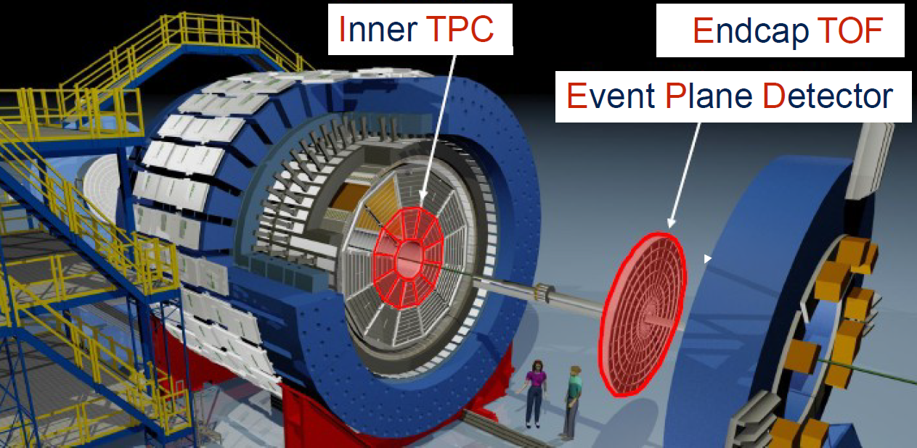
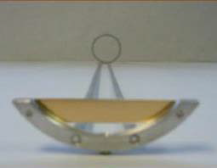
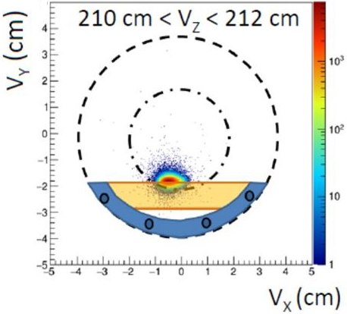
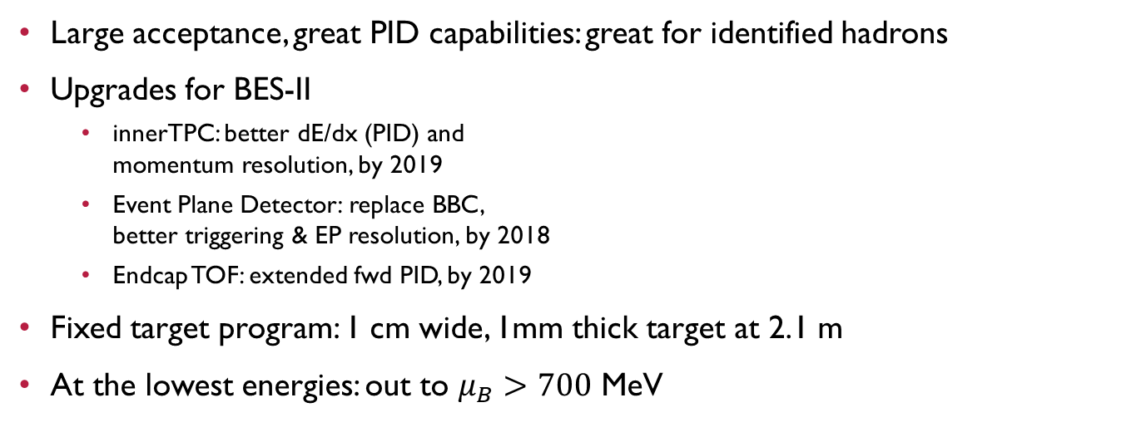
STAR: upgrades and fixed target program
Large acceptance, great PID capabilities: great for identified hadrons
Upgrades for BES-II
  innerTPC: better dE/dx (PID) and
  momentum resolution, by 2019
  Event Plane Detector: replace BBC,
  better triggering & EP resolution, by 2018
  Endcap TOF: extended fwd PID, by 2019
Fixed target program: 1 cm wide, 1mm thick target at 2.1 m
At the lowest energies: out to $μ_{B}>700$ MeV
a 3.9 GeV event
INTRODUCTION BASIC OBSERVATIONS RECENT BES RESULTS LÉVY HBT

Slide 16
Fixed target Baryochemical Potentials
Reach down to 3 GeV in center of mass energy!
Collider Energy | Fixed Target Coll. Energy | Single Beam C.M. Energy | Rapidity | μ_{B}(MeV)
62.4 | 7.7 | 30.3 | 2.10 | 420
39.0 | 6.2 | 18.6 | 1.87 | 487
27.0 | 5.2 | 12.6 | 1.68 | 541
19.6 | 4.5 | 8.9 | 1.52 | 589
14.5 | 3.9 | 6.3 | 1.37 | 633
11.5 | 3.5 | 4.8 | 1.25 | 666
9.1 | 3.2 | 3.6 | 1.13 | 699
7.7 | 3.0 | 2.9 | 1.05 | 721
Energies unreachable in collider mode
INTRODUCTION BASIC OBSERVATIONS RECENT BES RESULTS LÉVY HBT

Slide 17

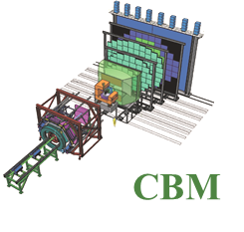
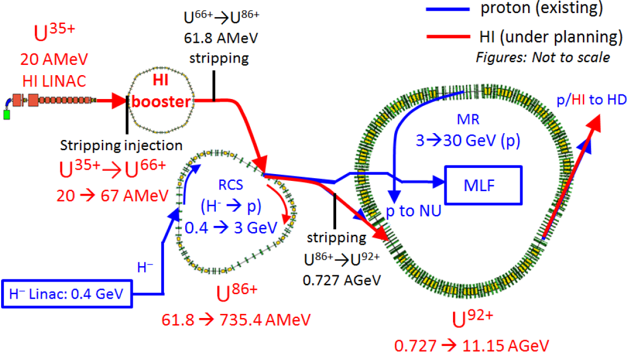
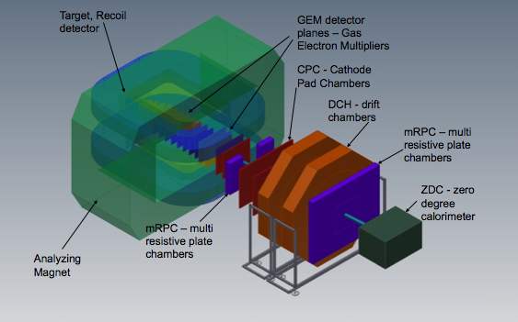


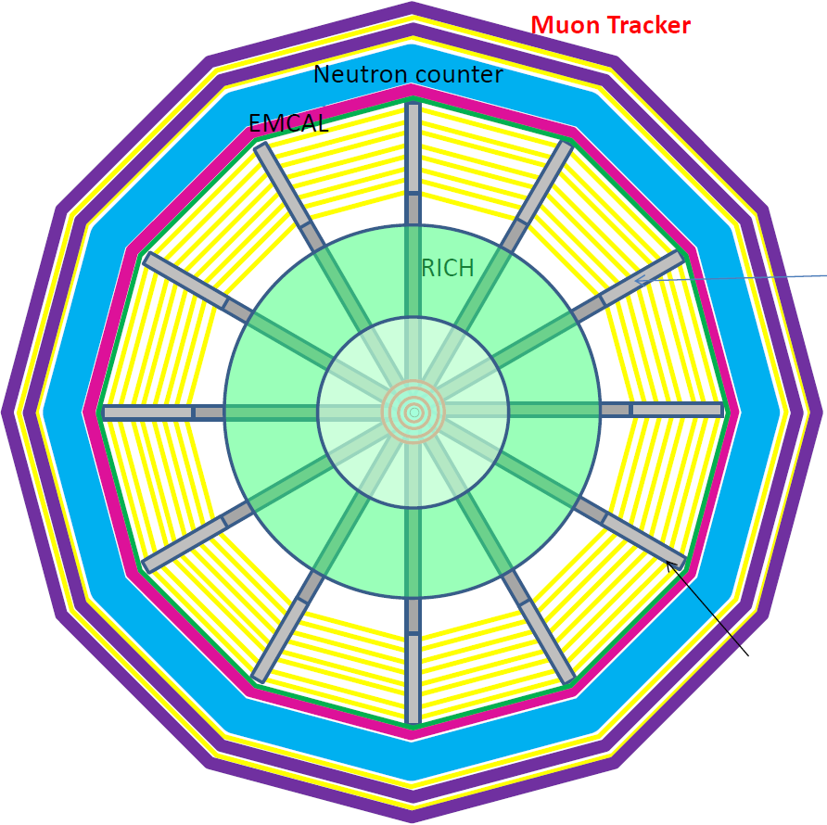
Future facilities: NICA, FAIR, J-PARC HI
New facilities planned/built
NICA: 2020, MPD&BM@N
FAIR: 2022, CBM
J-PARC HI: 2025, JHITS
SIS100/300
FAIR phase 1
FAIR phase 2
J-PARC HI
NICA
INTRODUCTION BASIC OBSERVATIONS RECENT BES RESULTS LÉVY HBT

Slide 18
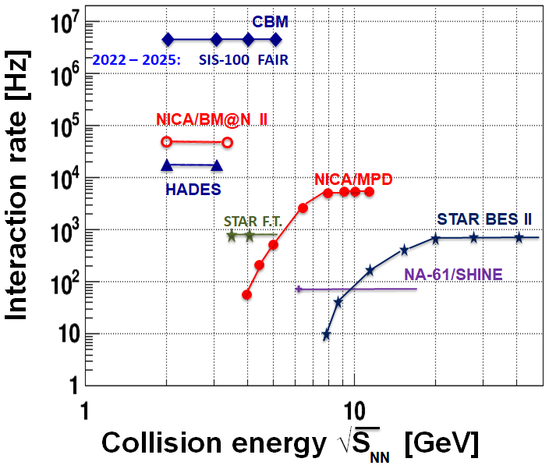
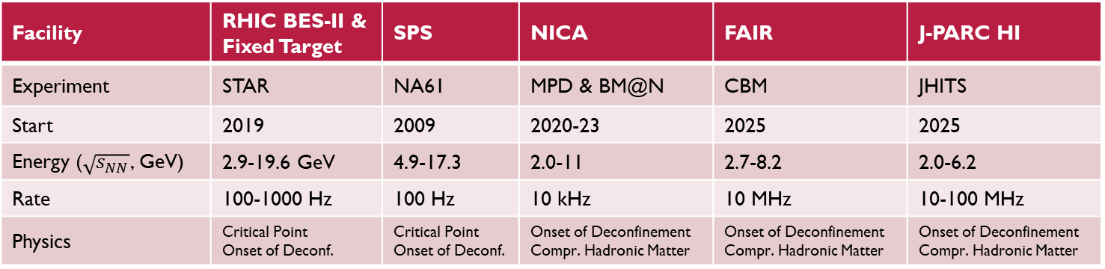
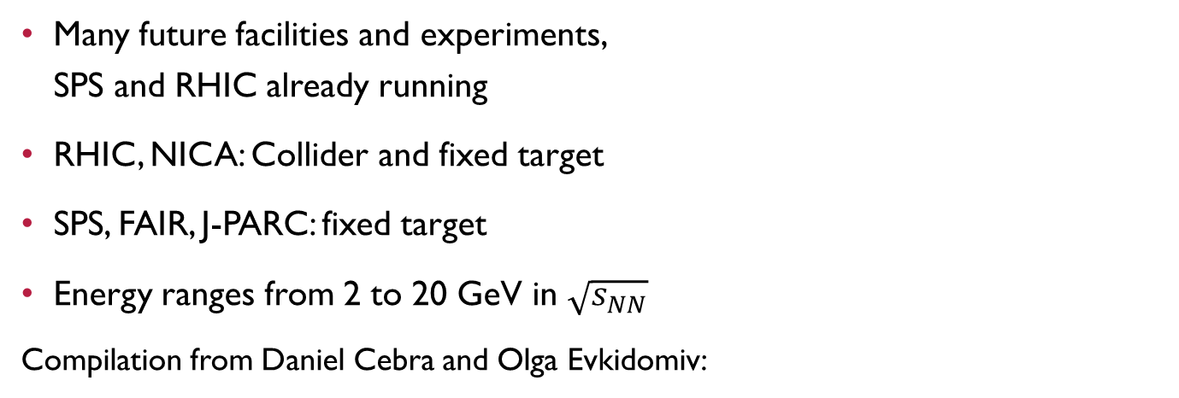
(FUTURE) FacilitIES comparison
Many future facilities and experiments,
SPS and RHIC already running
RHIC, NICA: Collider and fixed target
SPS, FAIR, J-PARC: fixed target
Energy ranges from 2 to 20 GeV in $\sqrt{s_{NN}}$
Compilation from Daniel Cebra and Olga Evkidomiv:
Facility | RHIC BES-II & Fixed Target | SPS | NICA | FAIR | J-PARC HI
Experiment | STAR | NA61 | MPD & BM@N | CBM | JHITS
Start | 2019 | 2009 | 2020-23 | 2025 | 2025
Energy ($\sqrt{s_{NN}}$, GeV) | 2.9-19.6 GeV | 4.9-17.3 | 2.0-11 | 2.7-8.2 | 2.0-6.2
Rate | 100-1000 Hz | 100 Hz | 10 kHz | 10 MHz | 10-100 MHz
Physics | Critical Point Onset of Deconf. | Critical Point Onset of Deconf. | Onset of Deconfinement Compr. Hadronic Matter | Onset of Deconfinement Compr. Hadronic Matter | Onset of Deconfinement Compr. Hadronic Matter
INTRODUCTION BASIC OBSERVATIONS RECENT BES RESULTS LÉVY HBT

Slide 19
Basic sQGP observations
Nuclear modification
Elliptic flow
Direct photons
Heavy flavor
Bose-Einstein correlations
Critical point observables
INTRODUCTION BASIC OBSERVATIONS RECENT BES RESULTS LÉVY HBT

Slide 20
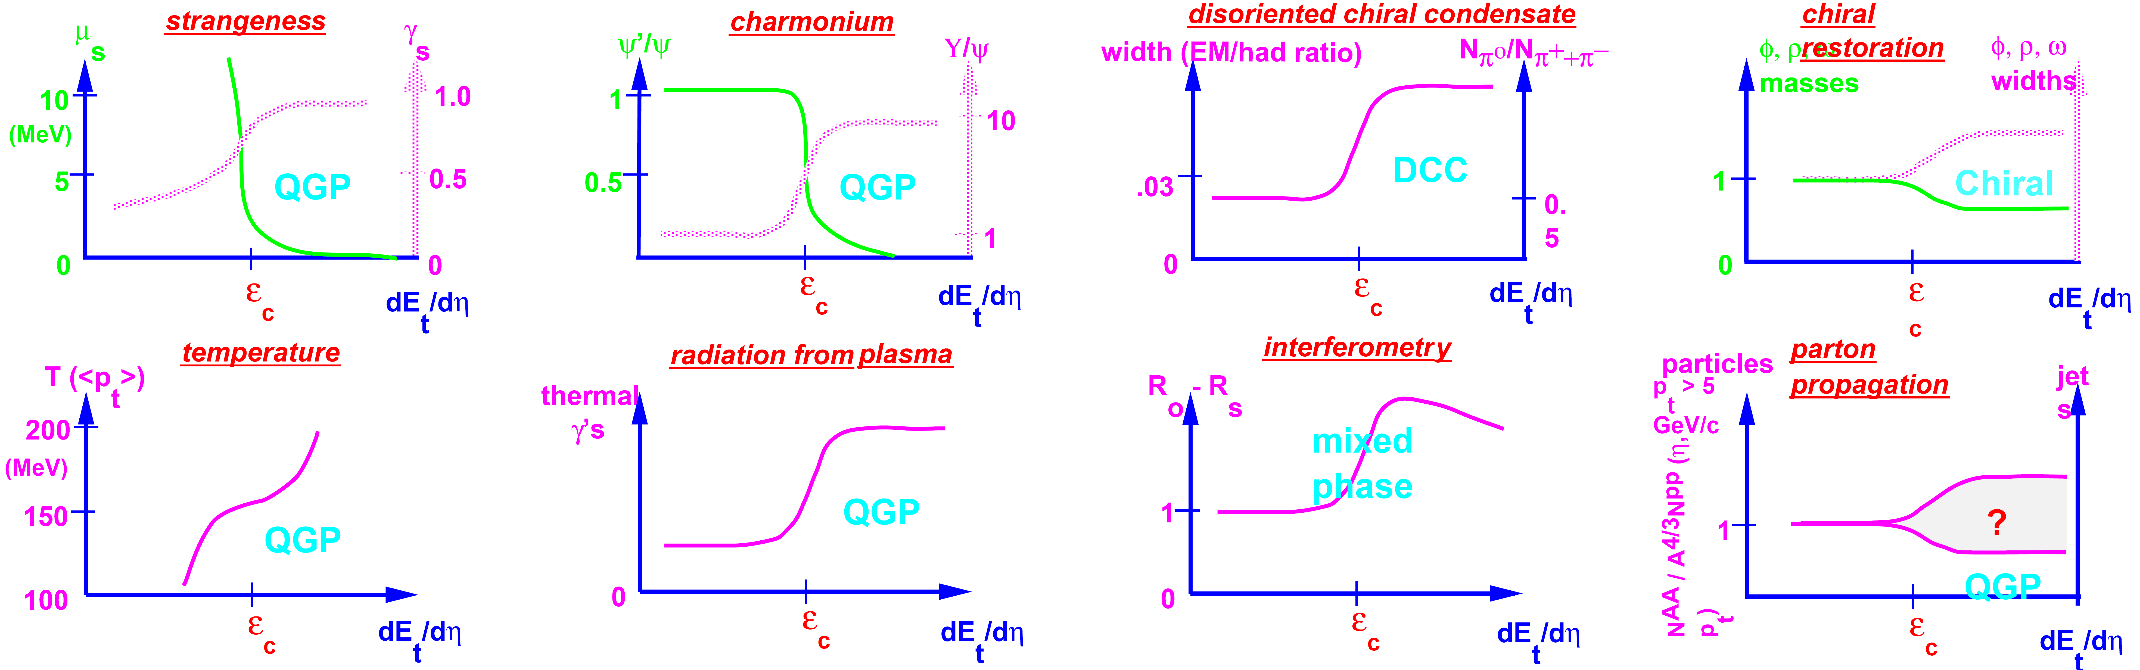

QGP signatures Expectations, 1996
Critical energy density: $ε_{c}≈1 \text{GeV}/{\text{fm}}^{3}$, temperature $T_{c}≈170 MeV$
Some observed, some not…
J. Harris & B. Mueller, „The Search for the QGP”, Ann.Rev.Nucl.Part.Sci. 46 (1996) 71 [hep-ph/9602235]
INTRODUCTION BASIC OBSERVATIONS RECENT BES RESULTS LÉVY HBT

Slide 21
Nuclear modification: tomography!
nucleus+nucleus
proton+proton
Simply just more?
A+A = many p+p?
High p_{T} particle yield in A+A
R_{AA}=
High p_{T} particle yield in p+p
×
Number of p+p collisions
INTRODUCTION BASIC OBSERVATIONS RECENT BES RESULTS LÉVY HBT

Slide 22
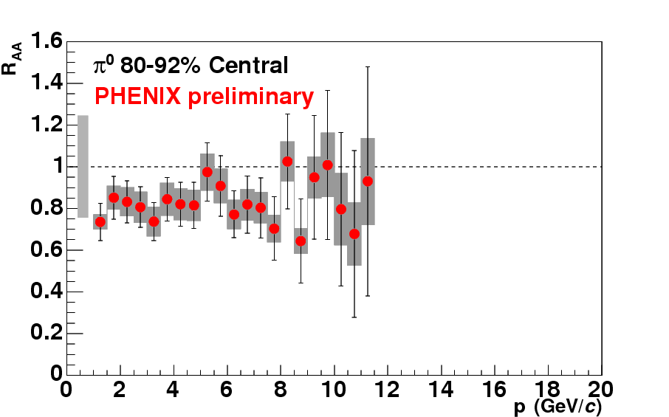
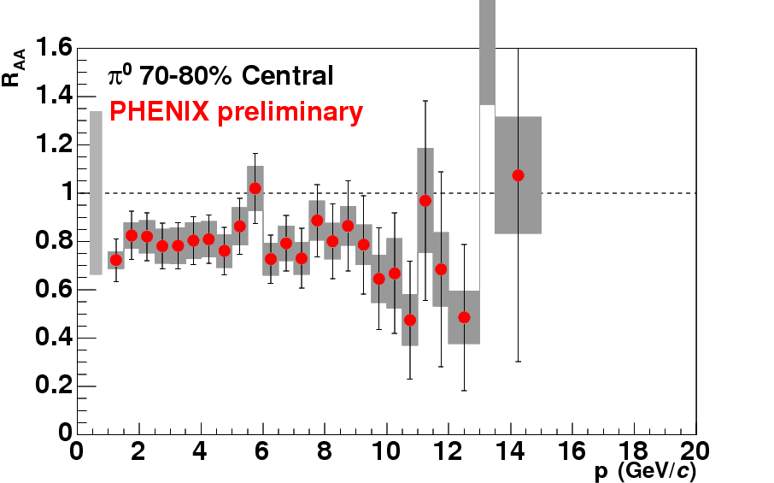
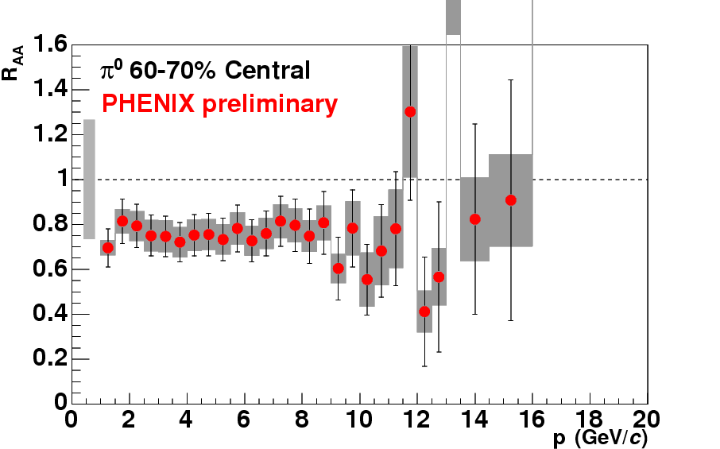
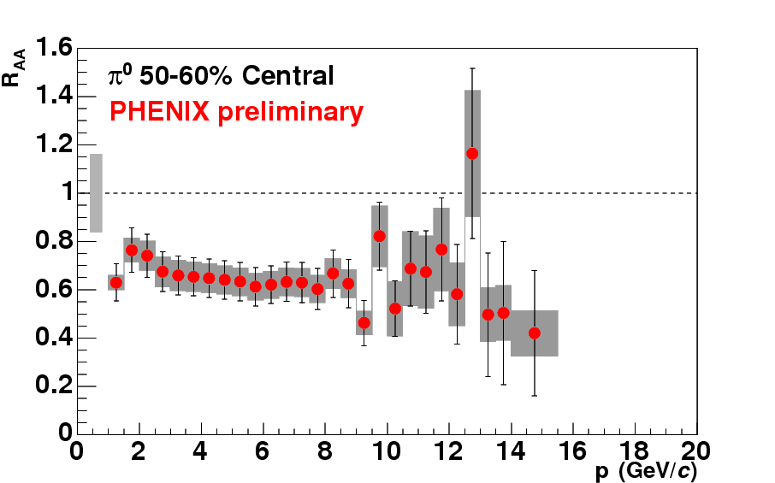
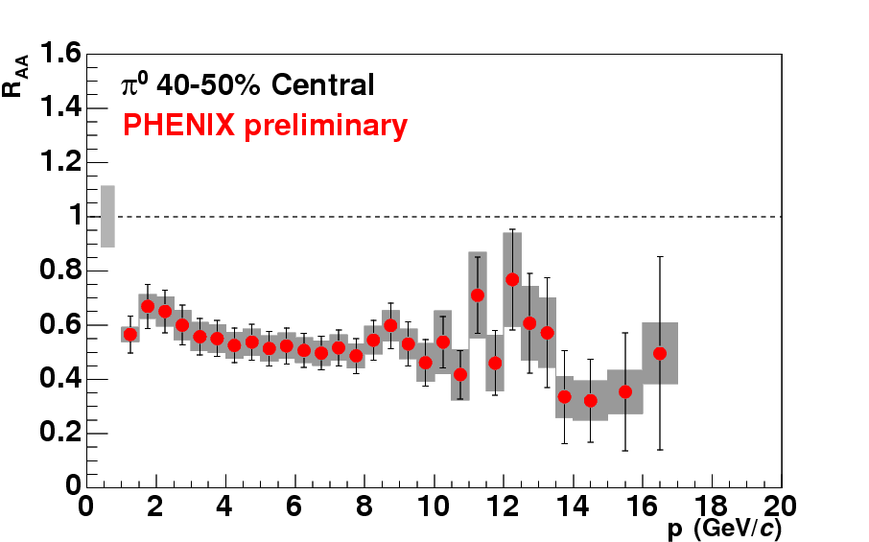
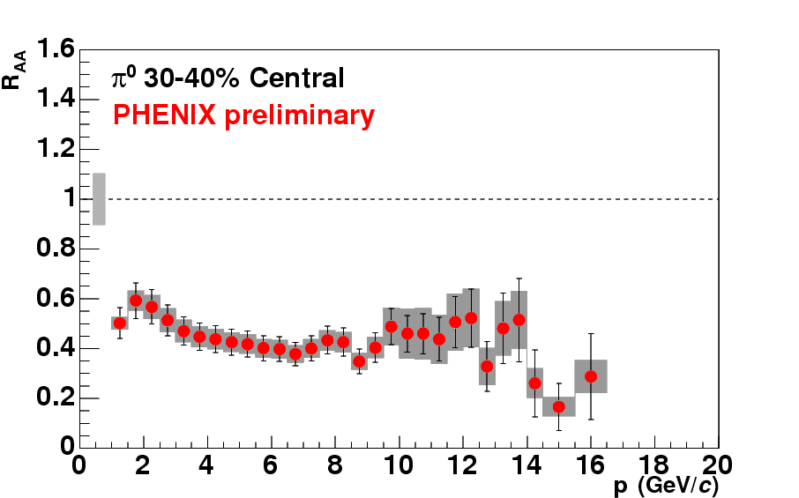
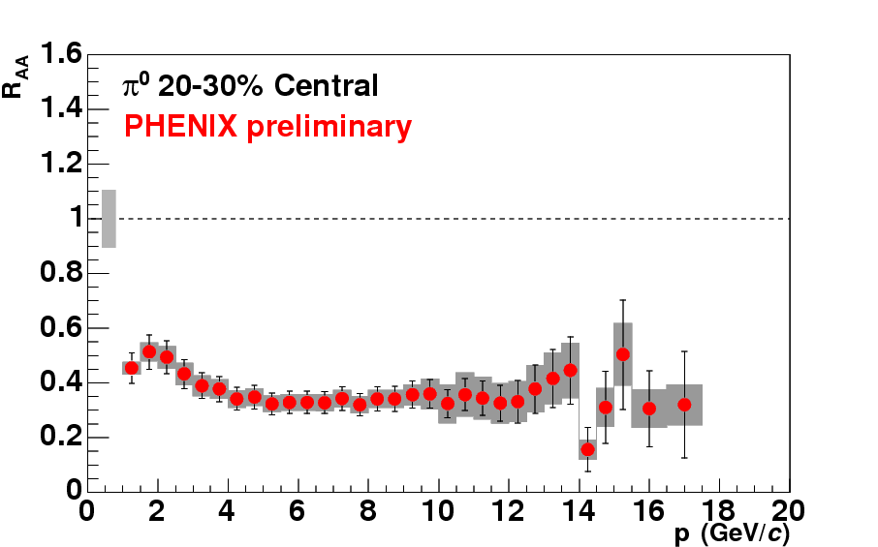
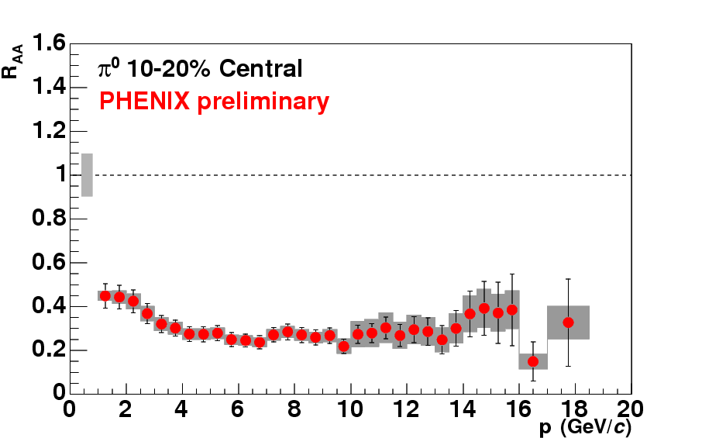
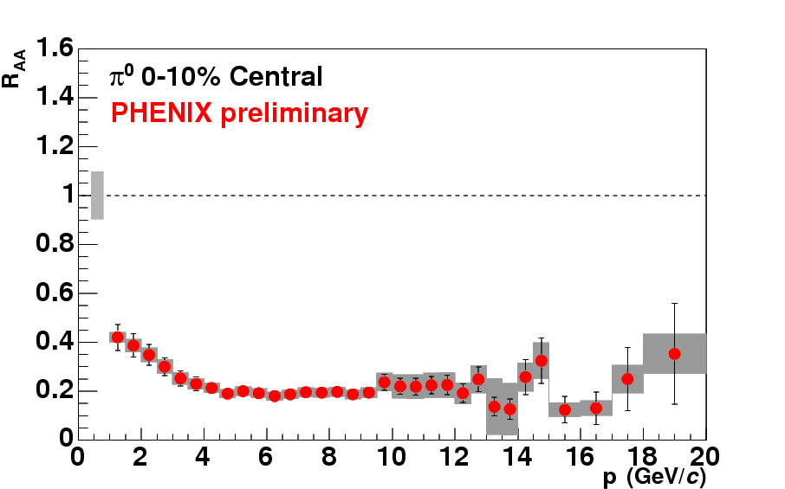
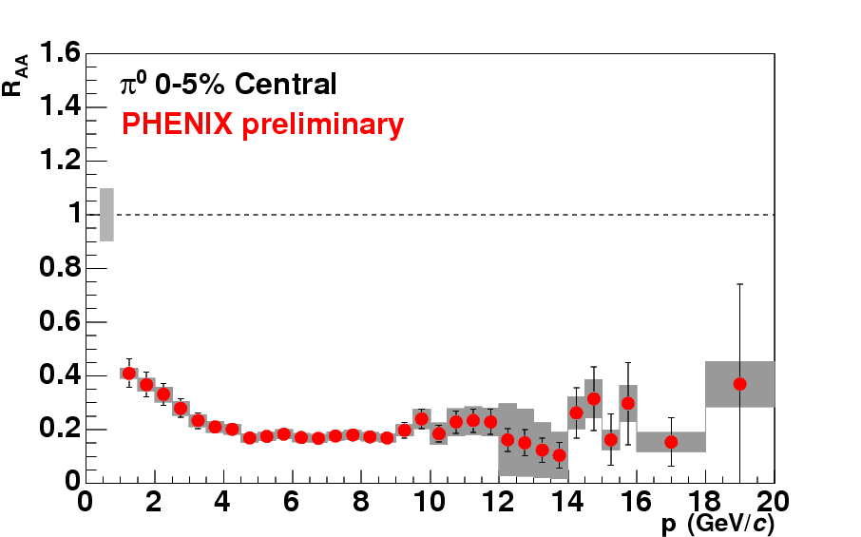
Suppression as a function of centrality
No suppression in d+Au or peripheral Au+Au; strong suppression in central!
Phys.Rev.C76:034904,2007
Enhanced
Suppressed
INTRODUCTION BASIC OBSERVATIONS RECENT BES RESULTS LÉVY HBT

Slide 23
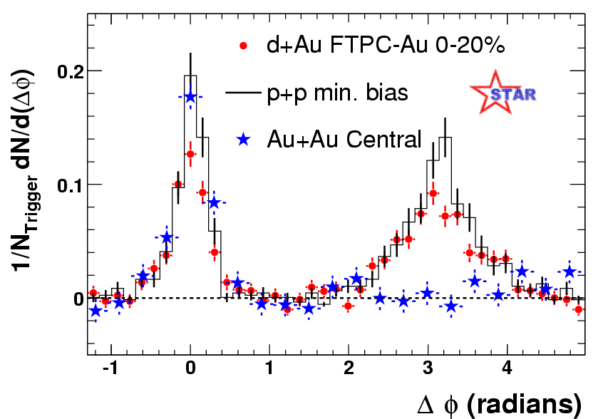
Suppression of the away side jet
Angular correlation of high energy hadrons
Outgoing jet: similar in p+p, d+Au, Au+Au
Inward going (away side) jet: missing in central Au+Au
PRL91(2003)072304
pedestal and flow subtracted
INTRODUCTION BASIC OBSERVATIONS RECENT BES RESULTS LÉVY HBT

Slide 24
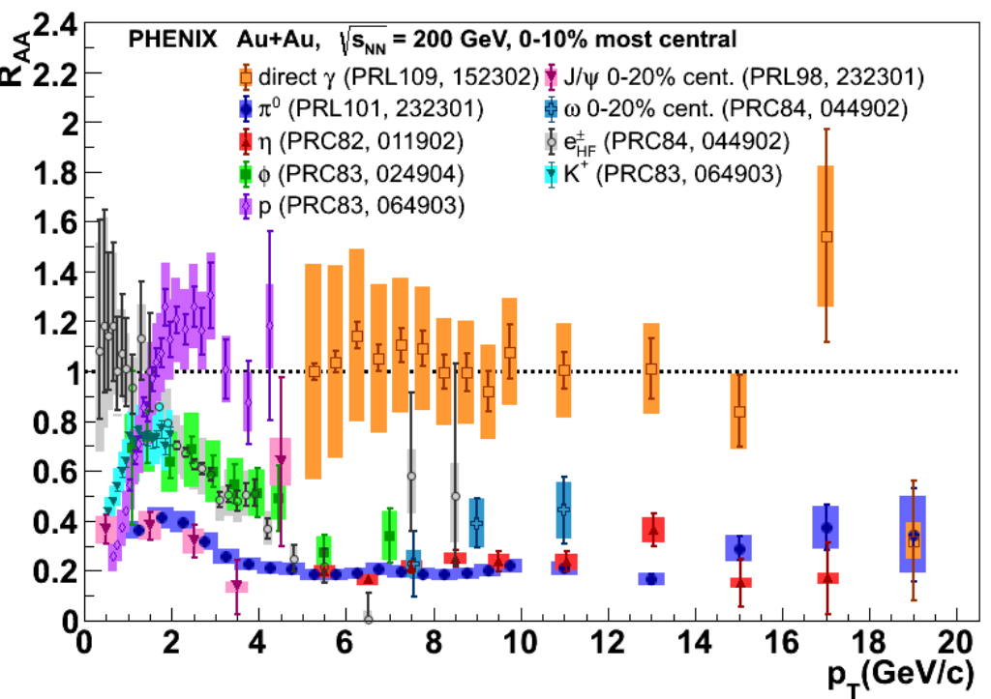
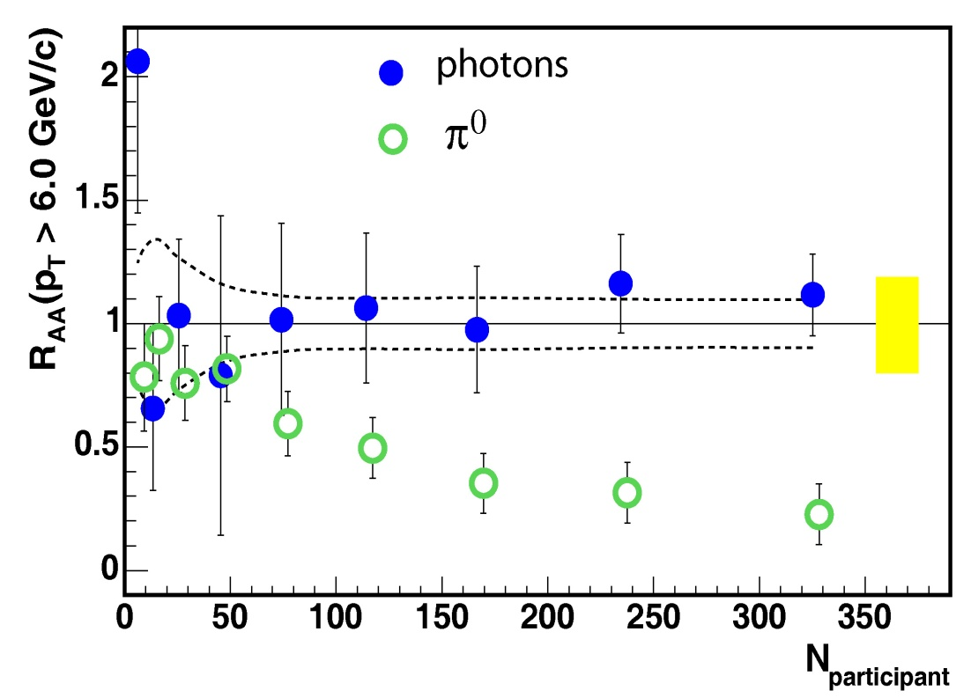

How do other particles behave?
All hadrons suppressed, direct photons „shine through”
Suppression dependent of system size (controlled by centrality or N_{part})
PHENIX Au+Au $\sqrt{s_{NN}}$=200 GeV
Phys.Rev.Lett. 94 (2005) 232301
INTRODUCTION BASIC OBSERVATIONS RECENT BES RESULTS LÉVY HBT

Slide 25
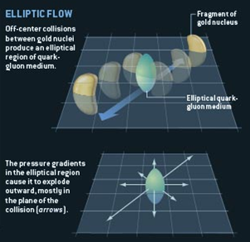
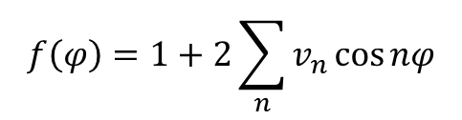
Observation of the elliptic flow
Spatial anisotropy creates
momentum-space anisotropy!
Quantified via
anisotropy
parameters
Zajc, Riordan, Scientific American
φ
$$f\left(φ\right)=1+2\sum_{n}{v_{n}\cos{nφ}}$$
ϕ
0 π 2π
INTRODUCTION BASIC OBSERVATIONS RECENT BES RESULTS LÉVY HBT

Slide 26




Elliptic flow scaling
Hydro predicts scaling ($v_{2}$ versus $w\sim E_{K}/T_{eff}$)
Coalescence predicts quark number scaling
$$E_{K}^{hadron}=n_{q}E_{K}^{quark}$$
$$v_{n}^{hadron}\left(E_{K}^{hadron}\right)≅n_{q}v_{n}^{quark}\left(E_{K}^{quark}\right)$$
Flow develops in pre-hadronic stage!
Csanád, Csörgő, Lörstad, Ster (NPA742:80-94,2004)
Csanád, Csörgő, Lörstad, Ster et al. (EPJA38:363-368,2008)
PHENIX, PRL98(2007)162301; STAR, PRL116(2016)62301
INTRODUCTION BASIC OBSERVATIONS RECENT BES RESULTS LÉVY HBT

Slide 27





heavy flavor suppression & regeneration
Timeline: quarkonium ($\text{q}\overline{\text{q}}$) formation $→$ QGP evolution $→$ $\text{q}\overline{\text{q}}$ decay
Quarkonia experience the whole QGP evolution, competing processes
Suppression due to color-screening: temperature and size/mass dependence
Statistical
regeneration
in time:
Images from J Castillo, SQM17 and A Mócsy, HardProbes2009
INTRODUCTION BASIC OBSERVATIONS RECENT BES RESULTS LÉVY HBT

Slide 28


Thermal photons
Soft component in direct photon spectrum
compared to p+p extrapolation
These are thermal photons!
Large initial temperature, 3-600 MeV!
Low momentum direct photon enhancement
PRC 91,064904
INTRODUCTION BASIC OBSERVATIONS RECENT BES RESULTS LÉVY HBT

Slide 29


Bose-Einstein correlations
Quantum statistics connects spatial and momentum space distributions
Spatial source $S(x)$ versus momentum correlation function $C_{2}\left(q\right)$:
$C_{2}\left(q\right)≅1+{\left|\tilde{S}\left(q\right)/\tilde{S}\left(0\right)\right|}^{2}$, where $\tilde{S}\left(q\right)=∫S\left(x\right)e^{iqx}d^{4}x$, $q=p_{1}−p_{2}$
Final state interactions distort the simple Bose-Einstein picture
Coulomb interaction important, handled via two-particle wave function
Resonance pions: Halo around primordial Core
Bolz et al, Phys.Rev. D47 (1993) 3860-3870
Csörgő, Lörstad, Zimányi, Z.Phys. C71 (1996) 491-497
INTRODUCTION BASIC OBSERVATIONS RECENT BES RESULTS LÉVY HBT

Slide 30


HBT and the phase transition
C(q) usually measured in the Bertsch-Pratt pair coordinate-system
  out: direction of the average transverse momentum
  long: beam direction
  side: orthogonal to the latter two
R_{out}, R_{side}, R_{long} : HBT radii
Out-side difference → ∆τ emission duration
From a simple hydro calculation:
$R_{out}^{2}=\frac{R^{2}}{1+u_{T}^{2}m_{T}/T_{0}}+β_{T}^{2}Δτ^{2}$, $R_{side}^{2}=\frac{R^{2}}{1+u_{T}^{2}m_{T}/T_{0}}$
RHIC, 200 GeV: $R_{out}≈R_{side}$→ no strong 1st order phase trans.
Plus lots of other details: pre-equilibrium flow, initial state, EoS, ...
S. Chapman, P. Scotto, U. Heinz, Phys.Rev.Lett. 74 (1995) 4400
T. Csörgő and B. Lörstad, Phys.Rev. C54 (1996) 1390
S. Pratt, Nucl.Phys. A830 (2009) 51C
INTRODUCTION BASIC OBSERVATIONS RECENT BES RESULTS LÉVY HBT

Slide 31





Search for the CEp: Fluctuations
Static universality class: 3D Ising (or random field 3D Ising?)
Dynamic universality class? 1 or 3 slow modes? Finite size/time effects?
Look at cumulants: $C_{n}=\left\langle {\left(n−\left\langle n\right\rangle \right)}^{n}\right\rangle$, function of corr. length $ξ\sim {\left|T−T_{c}\right|}^{−ν}$
$C_{n}\sim ξ^{2.5n−3}$ $\left(C_{2}\sim ξ^{2},C_{3}\sim ξ^{4.5},C_{4}\sim ξ^{7}\right)$
Non-monotonicity at CEP:
Usual observables:
$$\frac{M}{σ^{2}}=\frac{C_{1}}{C_{2}}, Sσ=\frac{C_{3}}{C_{2}}, κσ^{2}=\frac{C_{4}}{C_{2}}$$
Finite size effects dampen
divergencies in $ξ$!
Stephanov, IJMPA20,4387(2005)
Stephanov, PRL102, 032301(2009)
Stephanov, PRL107, 052301(2011)
Asakawa et al., PRL103, 262301(2009)
Hatta et al., PRL91,102003(2003)
$$\frac{C_{4}}{C_{2}}$$
$$T$$
STAR, PRL113(2014)092301
STAR, PRL112(2014)032302
INTRODUCTION BASIC OBSERVATIONS RECENT BES RESULTS LÉVY HBT

Slide 32

Search for the CEP, finite size/time effects
Finite size limits correlation length: $ξ\sim {\left|T−T_{c}\right|}^{−ν}$ but $ξ<L$!
Only a pseudocritical point can be observed
Clear influence on the phase diagram
Convenient situation: finite size scaling
discloses CEP location
and universality class
  Shift: $\sim L^{−1/ν}$
  Broadening: $\sim L^{−1/ν}$
  Dampening: $\sim L^{−γ/ν}$
T>T_{c}
T near T_{c}
INTRODUCTION BASIC OBSERVATIONS RECENT BES RESULTS LÉVY HBT

Slide 33
Summary of the status quo
Jet suppression in A+A
Lack of suppression in d+A
Photons shine through, thermal photons prevail at low momenta
Scaling of the elliptic flow: hydrodynamic medium, quark degrees of freedom
Heavy flavour suppression appears
Bose-Einstein correlations: no 1st order phase transition; 2nd order?
Correlations and fluctuations to search for the CEP
Finite size and time effects important!
INTRODUCTION BASIC OBSERVATIONS RECENT BES RESULTS LÉVY HBT

Slide 34
Results from the bes
Spectra and yields
Nuclear modification
Thermal photons
Heavy flavor
Elliptic flow
Bose-Einstein correlations
Finite size scaling
Intermittency
INTRODUCTION BASIC OBSERVATIONS RECENT BES RESULTS LÉVY HBT

Slide 35



Freeze-out from particle yields
Chemical and kinetic freeze-out parameters via THERMUS and BlastWave
Thermal multiplicity assumption valid
Systematics investigated (parameter constraints, included species)
Separation of T_{ch} and T_{kin} around $\sqrt{s_{NN}}=$4-5 GeV, T_{ch} flattens at ~10 GeV
STAR Collaboration, Phys. Rev. C 96, 044904 (2017) [arXiv:1701.07065]
INTRODUCTION BASIC OBSERVATIONS RECENT BES RESULTS LÉVY HBT

Slide 36



Particle ratios
AGS, SPS, RHIC, LHC data included
The K/π „horn” still there:
onset of deconfinement?
$π^{−}>π^{+}$: baryon decays ($Λ→pπ$)
Baryon stopping at small $\sqrt{s}$
Proton, kaon pair-prod. at high $\sqrt{s}$
STAR Collaboration,
Phys. Rev. C 96, 044904 (2017)
[arXiv:1701.07065]
INTRODUCTION BASIC OBSERVATIONS RECENT BES RESULTS LÉVY HBT

Slide 37


Suppression in the Beam Energy Scan
R_{CP} analyzed here instead of R_{AA}, transition to above one with coll. energy
Hadron enhancement: Cronin-effect, radial flow, coalescence domination
Competing effects, HIJING reproduces enhancement w/o jet quenching
Identified particles: less suppression for kaons, enhancement for protons
STAR collaboration, Phys. Rev. Lett. 121, 032301 (2018) [arXiv:1707.01988]
INTRODUCTION BASIC OBSERVATIONS RECENT BES RESULTS LÉVY HBT

Slide 38



Direct photons
Clear direct $γ$ signal at lower energies
Yield scaling from RHIC to LHC
Effective photon temperature similar from 39 to 2760 GeV
Note overlapping mechanisms: hadron gas, sQGP, jets, bremsstrahlung, hard scatt.
INTRODUCTION BASIC OBSERVATIONS RECENT BES RESULTS LÉVY HBT

Slide 39

Elliptic flow in the beam energy scan
With Blast-Wave fits
Predictions for not fitted
particles agree well
Flow in all sytems!
STAR Collaboration,
PRC93, 014907 (2016)
INTRODUCTION BASIC OBSERVATIONS RECENT BES RESULTS LÉVY HBT

Slide 40

Elliptic flow scaling in the bes
STAR data on mesons from π to φ, baryons from p to Ω
Scaling everywhere, except φ below 11.5 GeV, but little statistics
Phys. Rev. C 88 (2013) 14902
Phys. Rev. C 93 (2016) 014907
Phys. Rev. Lett. 116 (2016) 062301
INTRODUCTION BASIC OBSERVATIONS RECENT BES RESULTS LÉVY HBT

Slide 41




Side-note: flow in small systems
Origin of final state collectivity?
Due to strongly coupled liquid (the sQGP)?
  Small amount of time enough: d+Au at 20 GeV
Role of initial geometry?
  Test p+Au, d+Au, ³He+Au
  Hydro models describe flow data (elliptic & triangular)
  Nature Physics (2019)
  (on March cover)
  [arXiv:1805.02973]
INTRODUCTION BASIC OBSERVATIONS RECENT BES RESULTS LÉVY HBT

Slide 42



Search for the CEP: FluCtuations
Changing trend for net-protons at $\sqrt{s_{NN}}$ ~ 20 GeV for p_{T} up to 2 GeV
No such trend for kaons (for p_{T} up to 1.6 GeV)
Kaons less
sensitive than
protons
Models don’t
reproduce
net-proton data
More data
to be collected
in BES-II
Roli Esha, QM17
STAR, Phys. Lett. B 785 (2018) 551
INTRODUCTION BASIC OBSERVATIONS RECENT BES RESULTS LÉVY HBT

Slide 43


Off-diagonal cumulants
Correlation matrix calclulated via
off-diagonal moments
$\left(\begin{matrix}σ_{Q}^{2} & σ_{Q,p}^{1,1} & σ_{Q,k}^{1,1} \\ σ_{p,Q}^{1,1} & σ_{p}^{2} & σ_{Q,p}^{1,1} \\ σ_{k,Q}^{1,1} & σ_{p,Q}^{1,1} & σ_{k}^{2}\end{matrix}\right)$
Provides additional constraint on chemical freeze-out
Net-proton and net-kaon correlations:
change sign around 20-30 GeV
Q-k and Q-p correlations: above model calculations
CPOD/QM18
INTRODUCTION BASIC OBSERVATIONS RECENT BES RESULTS LÉVY HBT

Slide 44



Directed flow
$v_{1,p}(y)$ slope probes EoS softening
Hydro with 1st order phase trans: OK
e.g. Petersen et al. PRC78,044901(2008)
Hadronic transport & UrQMD fail
e.g. Isse et al. PRC72,064908(2005)
Net-protons: directed flow of “beam baryons”
More recently: net-kaon vs net-baryon
STAR, PRL120 (2018)062301
STAR Coll., PRL112 (2014)162301
INTRODUCTION BASIC OBSERVATIONS RECENT BES RESULTS LÉVY HBT

Slide 45


HBT radii and the search for the CEP
Signals of QCD CEP: softest point, long emission
$R_{out}^{2}−R_{side}^{2}$: related to emission duration
$(R_{side}−\sqrt{2}\overline{R})/R_{long}$: related to expansion velocity, $\overline{R}$: initial transverse size
Non-monotonic patterns
Indication of the CEP?
Further details in
Roy Lacey, arXiv:1606.08071 &
arXiv:1411.7931 (PRL114)
How about finite size scaling?
INTRODUCTION BASIC OBSERVATIONS RECENT BES RESULTS LÉVY HBT

Slide 46






Finite size effects and the CEP search
Finite size scaling analysis with $L=\overline{R}$, peak position and height tell $ν$ and $γ$
Critical EndPoint location for $L→∞$: $\sqrt{s_{NN}}≈47.5$ GeV
Scaling vs $t_{T}=\frac{T−T_{c}}{T_{c}},$ $t_{μ_{B}}=\frac{μ_{B}−μ_{B,c}}{μ_{B,c}}$: $T_{c}=165$ MeV & $μ_{B}=95$ MeV
Peak position [TeV]
$$\sim L^{−1/ν}→ν≈0.66$$
Peak height [fm²]
$$\sim L^{γ/ν}→ γ≈1.3$$
Very close to
3D Ising
Roy Lacey, PRL114 (2015),142301
INTRODUCTION BASIC OBSERVATIONS RECENT BES RESULTS LÉVY HBT

Slide 47


The NA61 picture: two “Onsets”
Onset of deconfinement: formation of non-hadronic medium (QGP)
Onset of fireball: formation of a single, statistically decaying cluster
Small clusters: wounded nucleon model
Percolation: overlapping clusters
Fireball: statistical decay
NA61 preliminary, CPOD2018
INTRODUCTION BASIC OBSERVATIONS RECENT BES RESULTS LÉVY HBT

Slide 48



Intermittency at SPS
Proton intermittency predicted to increase close to the CEP
Białas, Peschanski, Nucl.Phys.B273(1986)703;Turko, Phys.Lett.B227(1989)149
Observable: local power-law fluctuations of baryon density:
If $M$ bins in each dim: $F_{2}\left(M\right)=\frac{\left\langle \sum_{m=1}^{M^{2}}{n_{m}\left(n_{m}−1\right)}\right\rangle }{\left\langle \sum_{m=1}^{M^{2}}{n_{m}}\right\rangle }$
Measured in real and mixed event (reduce bkg)
CPOD2018
INTRODUCTION BASIC OBSERVATIONS RECENT BES RESULTS LÉVY HBT

Slide 49

Summary of the Recent results
Freeze-out curve mostly known down to $μ_{B}=400$ MeV
No very clear change in some usual observables down to 7.7 GeV
  Even small size and energy systems exhibit flow features
  Thermal photons appear also down to $\sqrt{s_{NN}}=39$ GeV
  Heavy flavor suppression similar over broad range
  No clearly apparent fluctuation in kaon and charge cumulant ratios
Note however:
  Lack of suppression for $\sqrt{s_{NN}}<20−30$ GeV
  Non-monotonicity in net-proton $κσ^{2}$
  Directed net-proton flow shows minimum: softest point?
  Non-monotonicity in the HBT radii, with finite size scaling relations tested
  Intermittency in Ar+Sc at SPS
Beam Energy Scan Phase II much awaited, along with future facilities!
INTRODUCTION BASIC OBSERVATIONS RECENT BES RESULTS LÉVY HBT

Slide 50


LÉvy distributions in heavy ion physics
Expanding medium, increasing mean free path: anomalous diffusion
Metzler, Klafter, Physics Reports 339 (2000) 1-77, Csanad, Csörgő, Nagy, Braz.J.Phys. 37 (2007) 1002
Lévy-stable distribution:
  Generalized Gaussian from generalized central limit theorem
  α = 2 Gaussian, α = 1 Cauchy
Shape of the correlation functions with Levy source:
Critical behavior → described by critical exponents
Spatial correlation ~ r^{-(d-2-η)} → defines critical exponent
Symmetric stable distributions (Lévy) → spatial corr. ~ r^{-1-α}
α alpha can be associated with the critical exponent eta
Csörgő, Hegyi, Zajc, Eur.Phys.J. C36 (2004) 67, nucl-th/0310042
$$ℒ\left(α,R;r\right)=\frac{1}{{\left(2π\right)}^{3}}\int{d^{3}qe^{iqr}e^{−\frac{1}{2}{\left|qR\right|}^{α}}}$$
$$C_{2}\left(q\right)=1+λ⋅e^{−{\left|qR\right|}^{α}} \begin{matrix}α=2:\text{Gaussian} \\ α=1:\text{Exponential}\end{matrix}$$
INTRODUCTION BASIC OBSERVATIONS RECENT BES RESULTS LÉVY HBT

Slide 51


Lévy index as a critical exponent?
QCD universality class ↔ 3D Ising
  Halasz et al., Phys.Rev.D58 (1998) 096007
  Stephanov et al., Phys.Rev.Lett.81 (1998) 4816
At the critical point:
  Random field 3D Ising: η = 0.50±0.05
  Rieger, Phys.Rev.B52 (1995) 6659
  3D Ising: η = 0.03631(3)
  El-Showk et al., J.Stat.Phys.157 (4-5): 869
Modulo finite size effects
Distance from the critical point?
Motivation for precise Lévy HBT!
Change in α_{Levy} proximity of CEP?
Non-static system, finite size effects may modify all this
2.0
1.0
0.5
Lévy index of stability $α$
-0.5 0 0.5
$$(T−T_{c})/T_{c}$$
INTRODUCTION BASIC OBSERVATIONS RECENT BES RESULTS LÉVY HBT

Slide 52




Lévy exponent α at 200 GeV
$$α=2.0$$
$$α=1.0$$
$$α=0.5$$
Measured value far from Gaussian (α = 2), inconsistent with expo. (α = 1)
Also far from the random field 3D Ising value at CEP (α = 0.5)
More or less constant (at least within systematic uncertainties)
Trend observable with statistical uncertainties only
INTRODUCTION BASIC OBSERVATIONS RECENT BES RESULTS LÉVY HBT

Slide 53

A side-note: relation to chiral symmetry
λ(m_{T}): core/(core+halo) fraction, may be connected to chiral restoration
  Decreased η’ mass → η’ enhancement → halo enhancement
  Kinematics: η’ decay pions will have low m_{T} → decreased λ(m_{T}) at low m_{T}
  Compatibility with unmodified in-medium η’ mass?
  Kapusta, Kharzeev, McLerran, Phys.Rev. D53 (1996) 5028, hep-ph/9507343
  Vance, Csörgő, Kharzeev, Phys.Rev.Lett. 81 (1998) 2205, nucl-th/9802074
  Csörgő, Vértesi, Sziklai, Phys.Rev.Lett. 105 (2010) 182301, arXiv:0912.5526
INTRODUCTION BASIC OBSERVATIONS RECENT BES RESULTS LÉVY HBT

Slide 54



Lévy exponent from 15 to 200 GeV
Lévy exponent $α$ still far from conjectured limit, interesting trends in $R$
Very much mT bin width dependenting, wait for final results…
INTRODUCTION BASIC OBSERVATIONS RECENT BES RESULTS LÉVY HBT

Slide 55


Summary
Clear consensus on a list of QGP signs
Some appear also at low energies, for small systems, no consensus yet
Beam Energy Scan Phase II starts now at RHIC
Strong efforts and plans also at SPS, NICA, FAIR, J-PARC
SPS
J-PARC HI
INTRODUCTION BASIC OBSERVATIONS RECENT BES RESULTS LÉVY HBT

Slide 56

Thank you for your attention
SPS
J-PARC HI
If you are interested in these subjects, come to our
Zimányi School 2019
December 2-6., Budapest, Hungary
http://zimanyischool.kfki.hu/19
INTRODUCTION BASIC OBSERVATIONS RECENT BES RESULTS LÉVY HBT

Slide 57
Backup slides
INTRODUCTION BASIC OBSERVATIONS RECENT BES RESULTS LÉVY HBT

Slide 58


Timeline of a heavy ion collision
Pre-thermalization stage:
~1 fm/c
Quark-hadron transition:
~7-10 fm/c
Chemical + kinetic freeze-out
INTRODUCTION BASIC OBSERVATIONS RECENT BES RESULTS LÉVY HBT

Slide 59


Control experiment: d+Au collisions
Suppression in Au+Au collisions: 1st milestone
Lack of suppression in d+Au: 2nd milestone
Two PRL covers
Au+Au
d+Au
Zajc, Riordan, Scientific American
INTRODUCTION BASIC OBSERVATIONS RECENT BES RESULTS LÉVY HBT

Slide 60

RHIC recorded runs and Luminosity
INTRODUCTION BASIC OBSERVATIONS RECENT BES RESULTS LÉVY HBT

Slide 61

Even heavy flavor flows!
Electrons from heavy flavor measured
Even heavy flavor is suppressed
Even heavy flavor flows
Strong coupling of charm&bottom to the medium
Small charm&bottom relaxation time in medium and small viscosity
INTRODUCTION BASIC OBSERVATIONS RECENT BES RESULTS LÉVY HBT

Slide 62



VISCOSITY
Viscosity/entropy density: proportional to mean free path
Strong coupling: small $η/s$
AdS_{D+1}/CFT_{D} lower bound: $\frac{η}{s}≥\frac{ℏ}{4π}$
  Malcadena et al.: Adv.Theor.Math.Phys.2:231-252,1998
  Kovtun et al.: Phys.Rev.Lett. 94 (2005) 111601
Measurement and calculation results:
  R. Lacey et al., Phys.Rev.Lett.98:092301,2007
  H.-J. Drescher et al., Phys.Rev.C76:024905,2007
  S. Gavin, M. Abdel-Aziz, Phys.Rev.Lett.97(2006)162302
  A. Adare et al. (PHENIX), PRL98:172301,2007
INTRODUCTION BASIC OBSERVATIONS RECENT BES RESULTS LÉVY HBT

Slide 63


J/Ψ in the Beam Energy Scan
Regeneration from c$\overline{\text{c}}$ and feed-down from $χ_{c}$ and $ψ^{′}$, increases with $\sqrt{s_{NN}}$
Screening and
cold nucl. matt.:
less primordial
charmonium with
increasing $\sqrt{s_{NN}}$
Two effects seem
to compensate for
$\sqrt{s_{NN}}<200$ GeV
STAR Collaboration, Phys.Lett. B771 (2017) 13-20
INTRODUCTION BASIC OBSERVATIONS RECENT BES RESULTS LÉVY HBT

Slide 64


J/Psi in the Beam Energy Scan
STAR Collaboration, Phys.Lett. B771 (2017) 13-20

Slide 65

Quark participant scaling
Transverse energy and particle number: not constant vs Npart!
Number of quark participants: a better estimator, quark degrees of freedom?
PHENIX Coll., Phys. Rev. C 93, 024901 (2016)
INTRODUCTION BASIC OBSERVATIONS RECENT BES RESULTS LÉVY HBT

Slide 66
PHENIX Levy HBT analysis
Dataset used for the analysis:
  Run-10, Au+Au, √s_{NN} = 200 GeV, 7.3∙10⁹ events
  Additional offline requirements: vertex less than 30 cm away from center
  Particle identification:
    time-of-flight data from PbSc East/West, TOF East/West, momentum, flight length
    2σ cuts on m² distribution
  Single track cuts: 2 σ matching cuts in TOF & PbSc for pions
  Pair-cuts:
    A random member of pairs assoc. with hits on same tower were removed
    customary shaped cuts in Δφ - Δz plane for Drift Chamber, PbSc East/West, TOF East/West
1D corr. func. as a function of |k|_{LCMS} in various m_{T} bins
  k_{LCMS} is 3-momentum difference in longitudinal co-moving system
  Levy fits for 31 m_{T} bins (0.228 < m_{T} < 0.871 GeV/c) with Coulomb effect
INTRODUCTION BASIC OBSERVATIONS RECENT BES RESULTS LÉVY HBT

Slide 67




Example C₂(|k|_{LCMS}) Correlation Function
Measured in 31 m_{T} bins
Fitted with Coulomb-
incorporated function
Coulomb-factor
displayed separately
All fits converged
Confidence levels
all acceptable
χ values scatter
around 0 properly
Physical parameters:
R, λ, α measured
versus pair m_{T}
$$λ$$
$$α$$
$$R$$
PHENIX, arXiv:1709.05649
INTRODUCTION BASIC OBSERVATIONS RECENT BES RESULTS LÉVY HBT

Slide 68

Lévy scale parameter R
Similar decreasing trend as Gaussian HBT radii
Hydro behavior not invalid
The linear scaling of 1/R², breaks for high m_{T}
INTRODUCTION BASIC OBSERVATIONS RECENT BES RESULTS LÉVY HBT

Slide 69





Newly discovered scaling parameter $\hat{\text{R}}$
$$λ(m_{T})$$
$$R(m_{T})$$
$$α(m_{T})$$
Empirically found scaling parameter
Linear in m_{T}
Physical interpretation: open question
INTRODUCTION BASIC OBSERVATIONS RECENT BES RESULTS LÉVY HBT

Slide 70

Lévy exponent $α$ at 39 and 64 GeV
Levy exponent : no significant change vs √s_{NN} at 39-62-200 GeV
Usual values between 1 and 1.5
Non-monotonicity in m_{T}
INTRODUCTION BASIC OBSERVATIONS RECENT BES RESULTS LÉVY HBT

Slide 71





$\hat{\text{R}}$ scaling: all energies and centralities
$α$ free
$α$ fixed
$α$ free
$α$ free
INTRODUCTION BASIC OBSERVATIONS RECENT BES RESULTS LÉVY HBT

Slide 72




Lévy Versus Gauss versus exponential
No tail if $α=2$, power law if $α<2$
$$R^{3}S_{core}(r)$$
$$R4πr^{2}S_{core}(r)$$
INTRODUCTION BASIC OBSERVATIONS RECENT BES RESULTS LÉVY HBT

Slide 73





Hole in λ(m_{T}): all investigated energies
Hole apparent for $\sqrt{s_{NN}}≥39$ GeV, all centralities
Due to reduced
$η^{′}$ mass?
Sign for chiral
restoration?
To be cross-checked
with photons,
dileptons, etc.
$α$ fixed
$α$ free
$α$ free
INTRODUCTION BASIC OBSERVATIONS RECENT BES RESULTS LÉVY HBT

Slide 74





Levy R: similar hydro trends for all cases
$α$ free
$α$ fixed
$α$ free
$α$ free
INTRODUCTION BASIC OBSERVATIONS RECENT BES RESULTS LÉVY HBT

Slide 75


Lévy exponent vs centrality at 200 GeV
Slightly non-monotonic behavior as a function of m_{T}
Average $\left\langle α\right\rangle$ non-monotonic behavior versus N_{part}
No clear interpretation or understanding of this trend
INTRODUCTION BASIC OBSERVATIONS RECENT BES RESULTS LÉVY HBT

Slide 76

LÉVY HBT Summary
Bose-Einstein correlation functions measured from 39 to 200 GeV
Levy fits yield statistically acceptable description
Fine m_{T} binned Levy source parameters (R, λ, α)
  Nearly constant α, away from 2, 1 and 0.5 $↔$ distance to CEP?
  Linear scaling of 1/R² vs m_{T} $↔$ hydro?
  Low-m_{T} decrease in λ(m_{T}) $↔$ chiral restoration, in-medium η’ mass?
New, empirically found scaling parameter $\hat{R}$=$\frac{R}{λ∙\left(1+α\right)}$
Centrality and collision energy dependence also explored
  No α decrease down to 39 GeV, non-monotonic α vs N_{part} dependence
  “Hole” in λ(m_{T}) present down to 39 GeV (c.f. SPS result without hole!)
  No change in 1/R² and 1/$\hat{\text{R}}$ scaling with centrality and $\sqrt{s_{NN}}$
INTRODUCTION BASIC OBSERVATIONS RECENT BES RESULTS LÉVY HBT

Slide 77
STAR beam use request for 2019
Assuming 24 cryoweeks
Event number estimates assume low-energy electron cooling ready mid-way through run & performs at design for 11.5 & 9.1 GeV running
Slide from Olga Evkidomov
BeamEnergy (GeV/nucleon) | √sNN(GeV) | RunTime | Species | NumberEvents | Priority | Sequence
9.8 | 19.6 | 4.5weeks | Au+Au | 400MMB | 1 | 1
7.3 | 14.5 | 5.5weeks | Au+Au | 300MMB | 1 | 3
5.75 4.6 | 11.5 9.11 | 5weeks 4weeks | Au+Au Au+Au | 230MMB 160MMB | 1 1 | 5 7
9.8 | 4.5 (FXT) | 2days | Au+Au | 100MMB | 2 | 2
7.3 | 3.9(FXT) | 2days | Au+Au | 100MMB | 2 | 4
5.75 | 3.5(FXT) | 2days | Au+Au | 100MMB | 2 | 6
31.2 | 7.7(FXT) | 2days | Au+Au | 100MMB | 2 | 8
19.5 | 6.2(FXT) | 2days | Au+Au | 100MMB | 2 | 9
13.5 | 5.2(FXT) | 2days | Au+Au | 100MMB | 2 | 10

Slide 78

Suppression in highly asymmetric sysytems
p+Au, d+Au, ³He+Au compared
Centralities determined
as for large systems
New p+Au results show
large centrality dependence
System sizes agree at high pT
At moderate pT, ordering seen
Model comparision:
  Vitev, HIJING++ investigated
  No full match of ordering,
  peak location, etc
N. Novitzky, QM17
INTRODUCTION BASIC OBSERVATIONS RECENT BES RESULTS LÉVY HBT

Slide 79


Elliptic flow in small systems
Deuteron-gold energy scan (19.6-200 GeV), PHENIX, PRC96, 064905 (2017)
superSONIC in good agreement at 62.4 GeV and 200 GeV
Underpredicts data at 19.6 GeV and 39 GeV
Data still contains nonflow effects: AMPT(EventPlane) w/ nonflow matches
INTRODUCTION BASIC OBSERVATIONS RECENT BES RESULTS LÉVY HBT

Slide 80


Elliptic flow in small systems
Mass ordering in all cases, smallest effect in p+Au
Hydro+… codes describe results well (superSONIC, iEBE-VISHNU)
  Shen et al, Phys.Rev. C95, 014906(2017); Habich et al, Eur.Phys.J. C 75, 15 (2015).
PRC 97, 064904 (2018)
PRL114,192301(2014)
PRC 97, 064904 (2018)
INTRODUCTION BASIC OBSERVATIONS RECENT BES RESULTS LÉVY HBT

